Slide 1

Supported Employment
Documentation of Services Training
Vienna Hoang
IVRS Resource Manager
2021

Slide 2

Documentation is a Part of the Process
Forms assist with the process and gathering information, they are NOT the process
Guidelines are set in place by IVRS and RSA however the JC, IVRS and the CRP relationship drives the process
Services and procedures are individualized to meet the needs of the individuals served
Documentation must be in the case file to show the story of the IVRS case file and are there not only to benefit IVRS but also the individuals served.

Slide 3
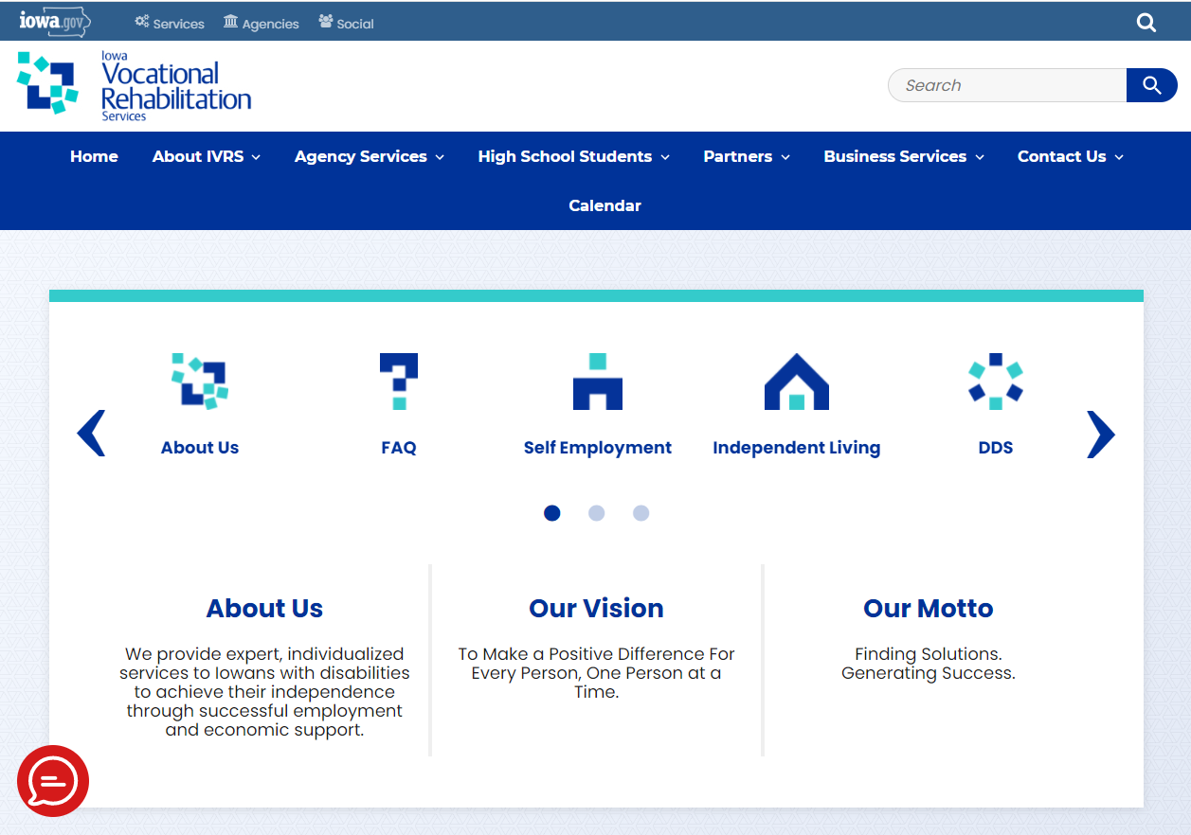
https://ivrs.iowa.gov

Slide 5
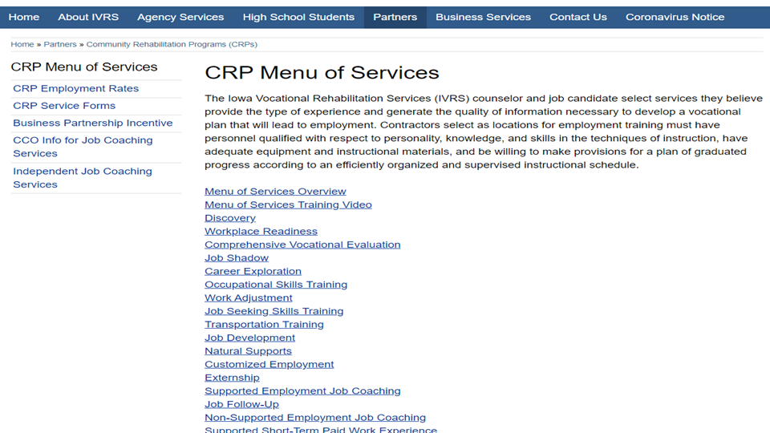

Slide 6

Referral
Purpose of the referral form:
Building the team of people who will help the JC achieve successful employment.
JC
JC’s guardian, family, good friend
IVRS Counselor
Long term support provider
CRP
SLP
HHA
Section I, Employment Analysis
The person referring for services through IVRS should complete the referral form and submit it to the VR Counselor.

Slide 7
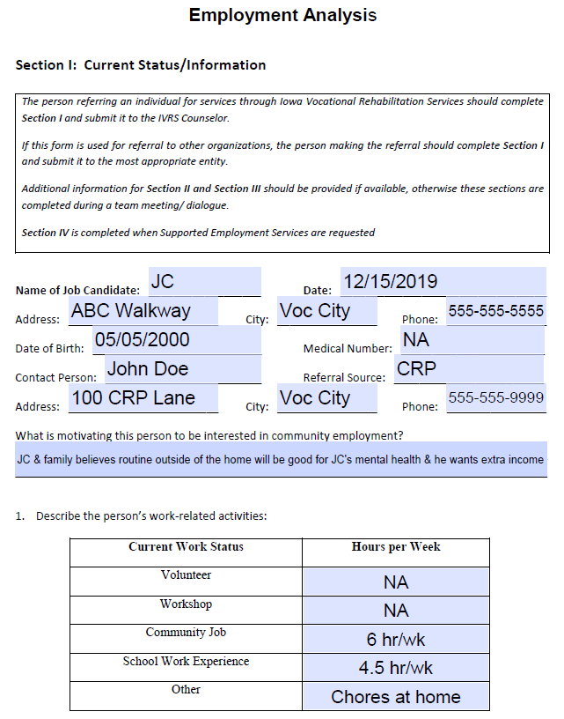
IVRS Referral Form
Basic information such as
  JC’s name
  Date form is completed
  JC’s home address
  JC’s date of birth
  Contact Person/Referral source info
Work related activities
  JC’s current work status
  Hours per week

Slide 8
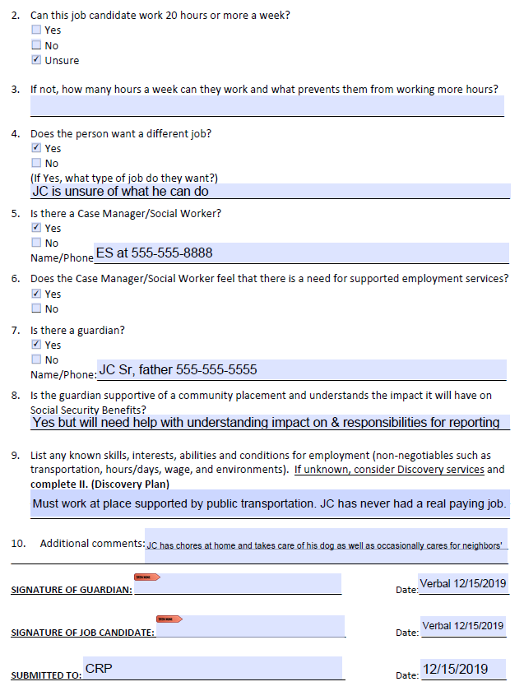
Next steps...
Decision(s) | Actions(s)/Date | Party Responsible
Discovery | Interview JC & those who know JC by end of April 2021 | JC, JC’s guardians, JC’s special ed teacher, employer(s), & CRP
Team meeting | Review results from Discovery by 4/30/2021 | JC, JC’s guardians, IVRS, CRP, & case manager

Slide 9

Discovery
Purpose of documentation:
Capture the plan for:
  How Discovery will be done
  Who will be interviewed
  Where will interviews be done
  When Discovery will be done
  How much time was spent on the activities
Capture the things that happen:
  JC’s behaviors, thoughts, insights & reactions
  Information from the thoughts, insights & reactions of those who know JC
  ES’s observations, insights & recommendations
Next steps: If more time is needed after the initial Discovery activities have been provided, the team will discuss further services that may be needed to help determine a job candidate’s interests, skills, contributions and conditions for employment. These may include:
  Workplace Readiness Assessments (WRA)
  Job Shadowing
  Career Exploration
Any of the various employment services should be delivered one service at a time.

Slide 10
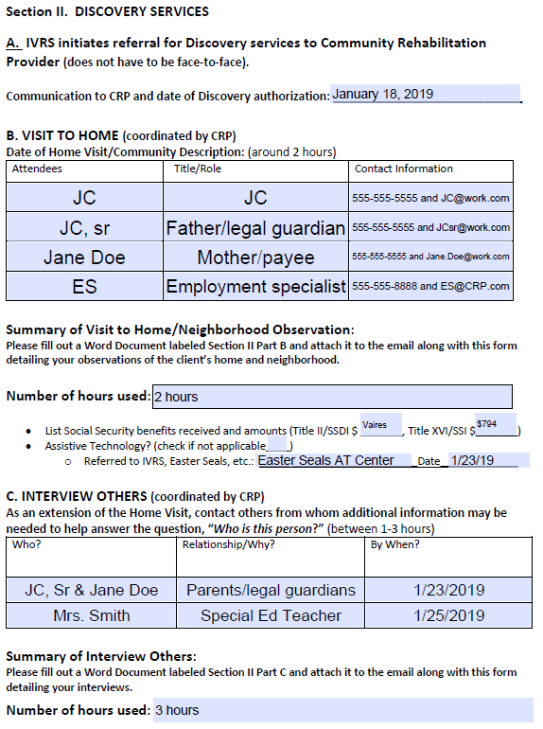
Discovery

Slide 11
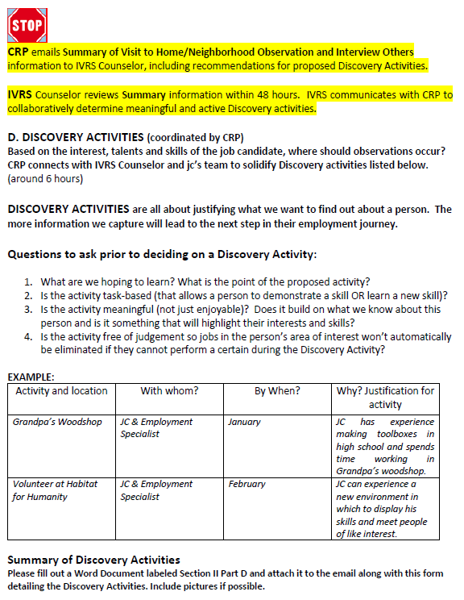
Discovery

Slide 12
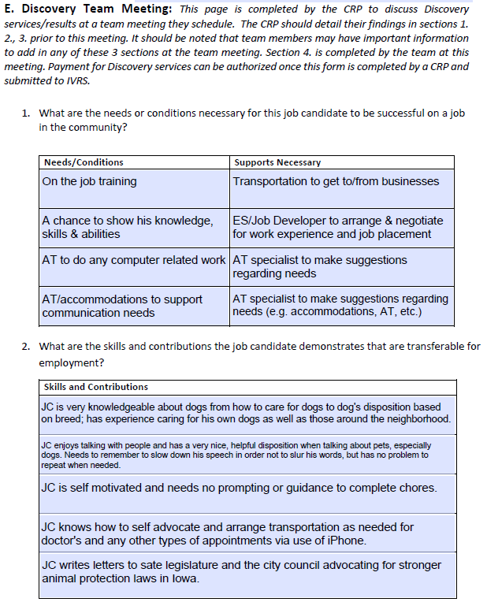
Discovery

Slide 13
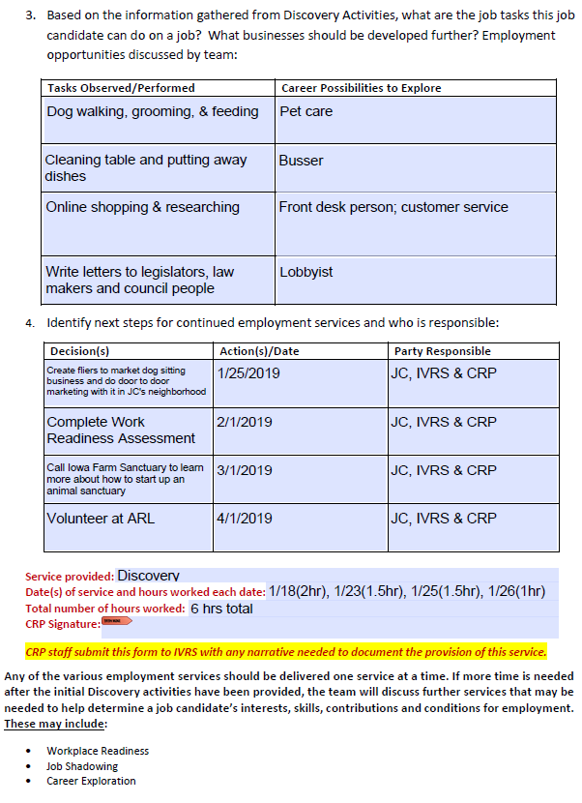
Discovery

Slide 14
Discovery
5 Key Aspects for the Documentation of Discovery Services
Answered - were all of the questions answered?
Detailed - does the report provide enough details?
Itemized - do the # of hours detailed in narrative match # of hours claimed
Unanswered - what wasn’t answered & new questions?
Recommendations - ES’s insight & expert opinion

Slide 15
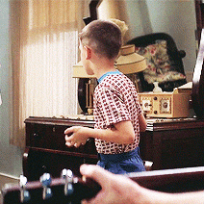
What is next for JC?
JC & team are still not sure what JC wants to do or can do?
Section III Vocational Assessment/Preparation/Training Services
Occupational Skills Training
JC & team are ready for job development?
Section IV Supported Employment Placement Agreement (SEPA)
Job Development Log
Job Development Monthly Report Form
Job Analysis Form
Plan for Natural Supports Form

Slide 16
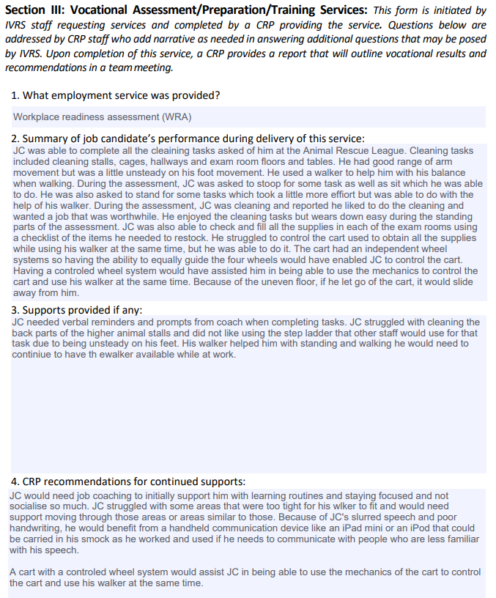
Section III Vocational Assessment/Preperation/Training Services
Workplace Readiness Assessment (WRA)
Job Shadow
Career Exploration
Work Adjustment Training (WAT)
Job Search Training (aka JSST)
Transportation Training

Slide 17
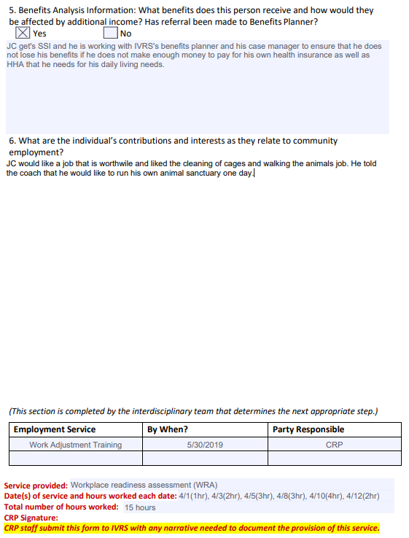
Section III Vocational Assessment/Preperation/Training Services
Workplace Readiness Assessment (WRA)
Job Shadow
Career Exploration
Work Adjustment Training
Job Search Training
Transportation Training

Slide 18
What is next for JC?
5 Key Aspects for the Documentation of WRAs, WATs & Transportation Training
Answered - were all of the questions answered through the hands on experiences?
Detailed - does the report provide enough details?
Itemized - do the # of hours detailed in narrative match # of hours claimed
Unanswered - what wasn’t answered & new questions?
Recommendations - ES’s insight & expert opinion
Key Aspects for the documentation of Job Shadows, Career Explorations & Job Search Training
Answered - what were all of JC’s questions for the employer, the answers & JC’s reactions to those answers?

Slide 19
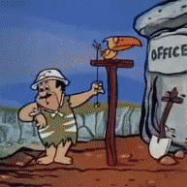
Occupational Skills Training
Purpose
The purpose of Occupational Skills Training (OST) is to assist a job candidate in developing specific work skills. Training may occur in partnership with a business or industry, or CRP providing the training. OST is designed to enhance the candidates’ ability to do a potential job identified in the community and also provide strategies on job retention skills.

Slide 20
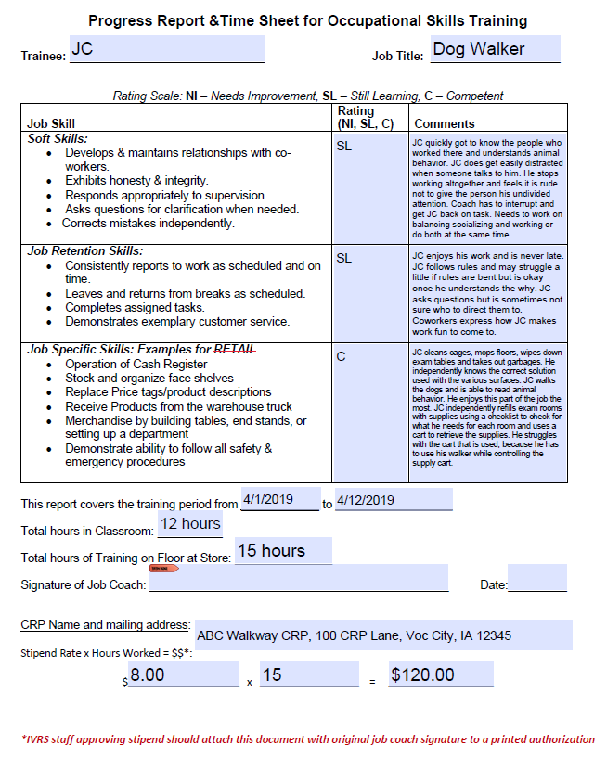
Occupational Skills Training

Slide 21
Occupational Skills Training
5 Key Aspects for the Documentation of OSTs
Answered - were all of the questions answered through the hands on experiences?
Detailed - does the report provide enough details?
Itemized - do the # of hours detailed in narrative match # of hours claimed
Unanswered - what wasn’t answered & new questions?
Recommendations - ES’s insight & expert opinion
Other documentation:
Certificates of completion
Industry recognized certifications

Slide 22

Comprehensive Vocational Evaluations
5 Key Aspects for the Documentation of Comp Voc Evals
Answered - were all of the questions answered?
Detailed - does the report provide enough details?
Itemized - do the # of hours detailed in narrative match # of hours claimed
Unanswered - what wasn’t answered & new questions?
Recommendations - ES’s insight & expert opinion
Other documents:
Tests
Test results

Slide 23
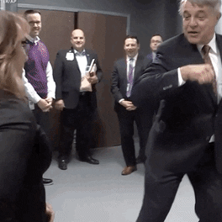
Job Development
Purpose:
Job Candidates with the most significant disability(ies)
Competitive Integrated Employment (CIE)
Service is to the business customer
Forms:
Supported Employment Placement Agreement (SEPA)
Job Development Log
Job Development Monthly Report Log
Job Analysis Form
Plan for Natural Supports Form

Slide 24
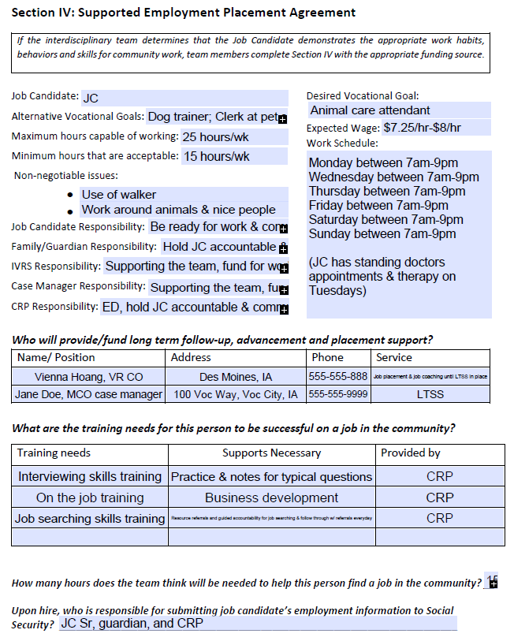
Job Development

Slide 25
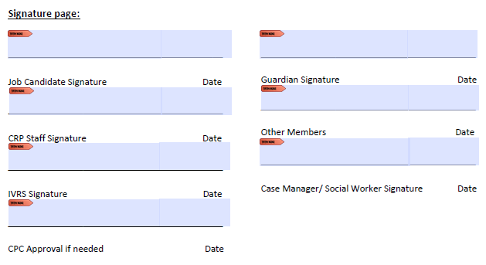
Supported Employment Placement Agreement (SEPA)

Slide 26
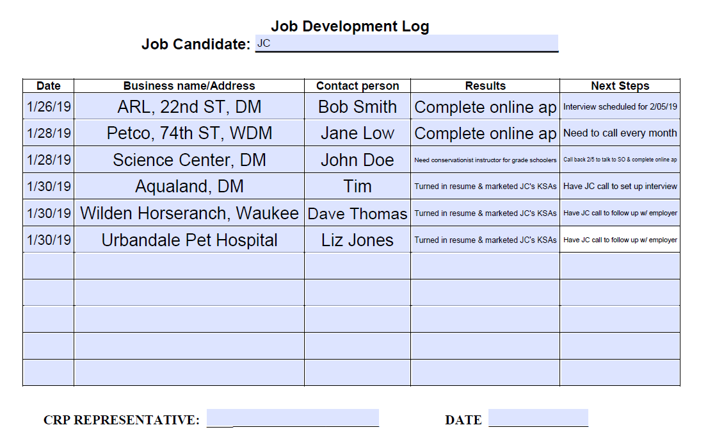

Slide 27
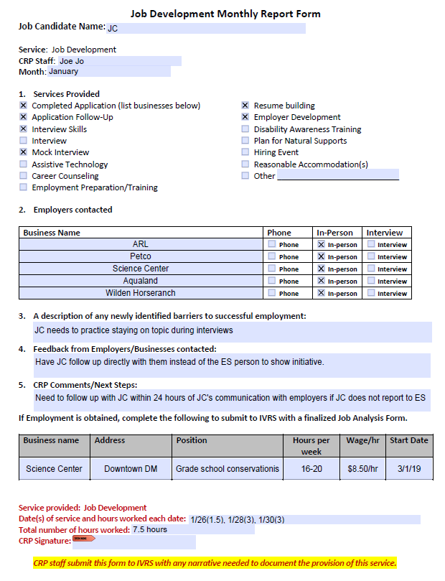
Job Development

Slide 28
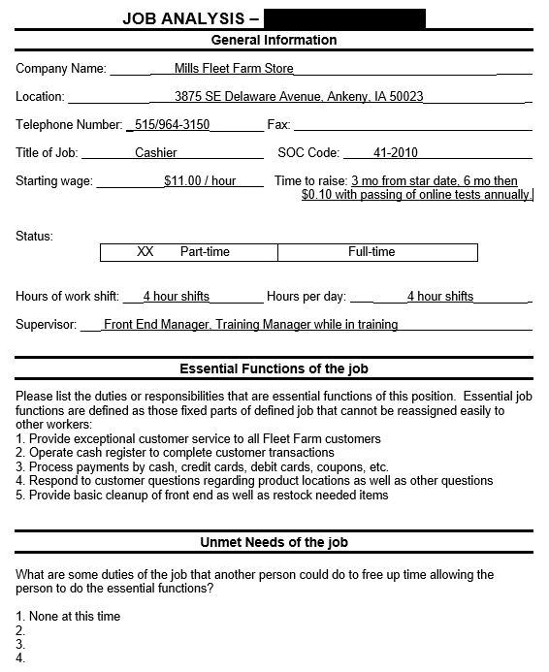

Job Analysis Report

Slide 29
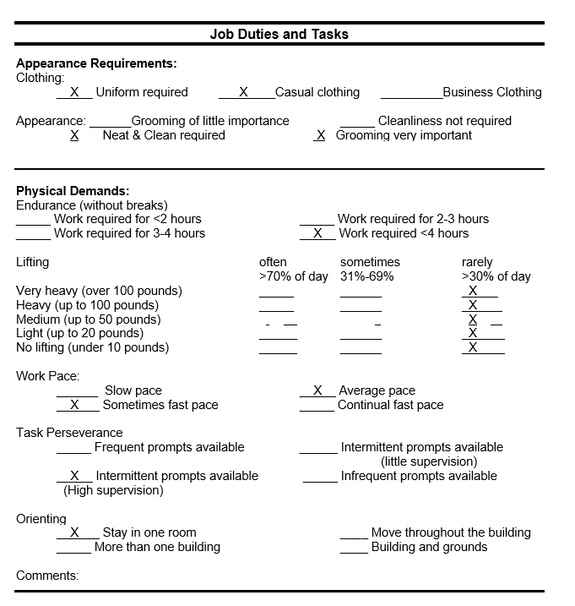
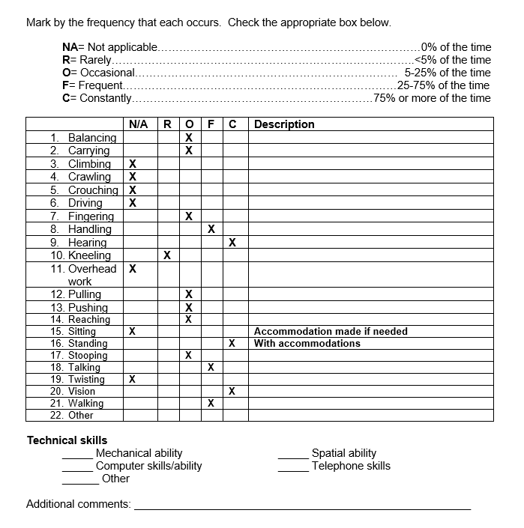

Slide 30
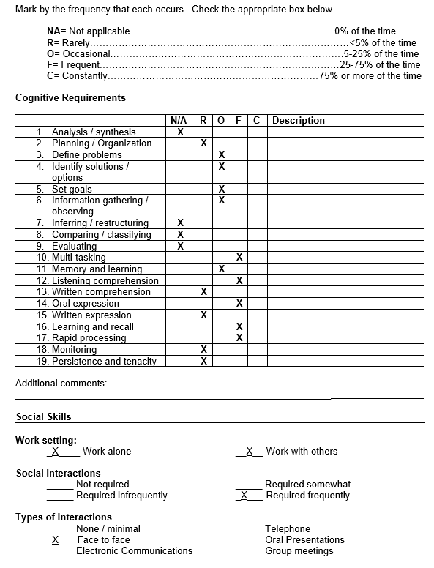
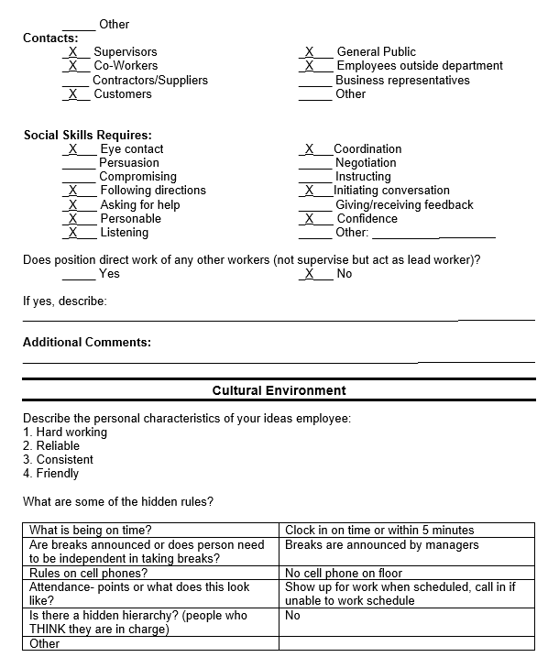

Slide 31
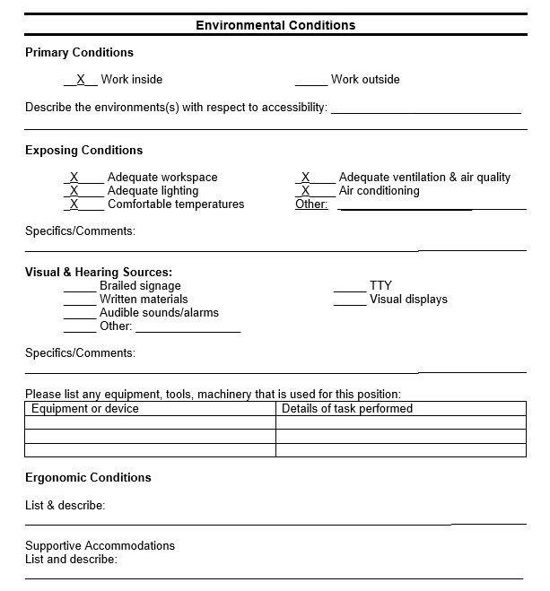
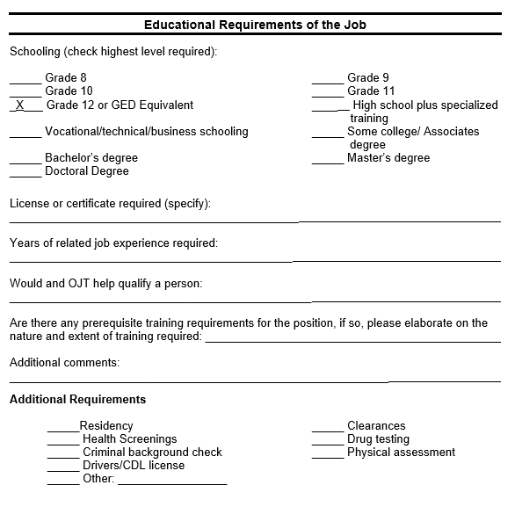

Slide 32
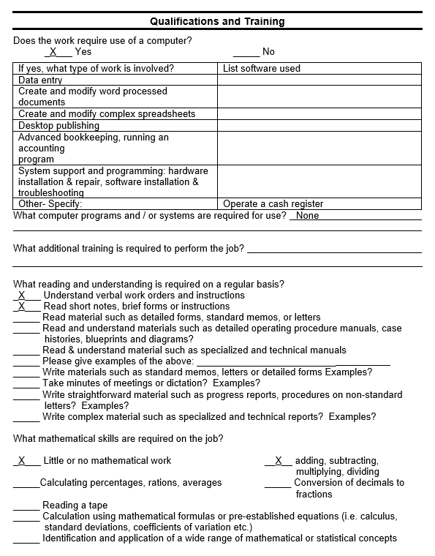
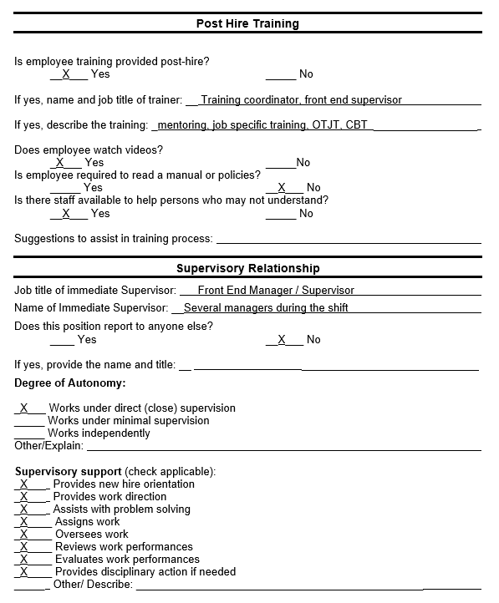

Slide 33
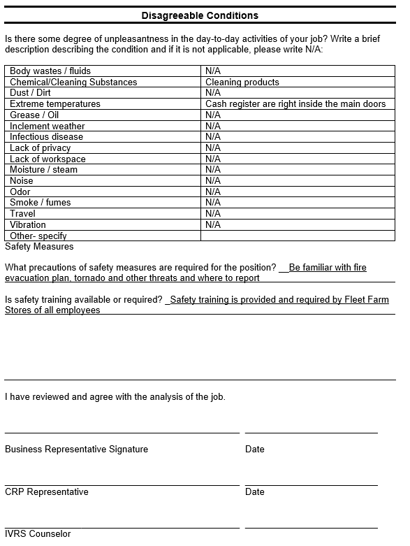
Job Analysis Report

Slide 34
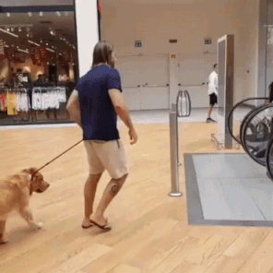
Plan for Natural Supports
PLAN FOR NATURAL SUPPORTS
A plan for natural supports should document the following:
Training has been provided to the natural supports that includes:
  Disability awareness for the natural supports (best practice would include the entire work unit);
  Training strategies and technique, taught to the natural support, that facilitates the learning and skill acquisition of the person with a disability;
  Communication strategies and person-first language that foster teaming and a welcoming environment;
  Communication and business culture specifics that aligns the work and chain of command protocols between the person with a disability and the employer;
  Work station design that facilitates co-worker relationship development
Identification of natural support and backup support should one of the supports be absent or resign.
Comments:

Slide 35
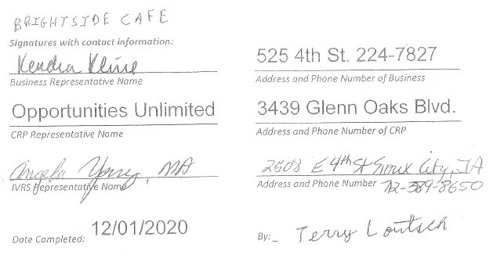
Plan for Natural Supports

Slide 36

Job Coaching (SES vs Non SES)
SES Job Coaching vs on the job supports short term (non supported employment job coaching)
  Can be MSD or SD to do Short term job coaching
  Has to be MSD to be SES Job Coaching

Slide 37

Supported Employment Job Coaching
The purpose of Supported Employment Job Coaching is to:
provide immediate feedback and moral support
train the candidate on the appropriate job specific skills, work habits, behaviors, and socialization
assist JC with adjust to the job
redirect JC to use the natural support plans developed

Slide 38

Documentation of Job Coaching
Job Candidate Name: JC
Services: Supported Job Coaching
CRP Staff: Joe Jo
Employment Location: ABC Drive, Voc City, IA 12345
Employment Start Date: 2/1/2019
A list of dates job coaching was provided: 2/1, 2/3, 2/5
Select the type of support provided to job candidate to become independent in employment. (Select all that apply):
Accommodations
Co-Worker Training
Job Training
Employment Barriers Addressed:
Attendance
Co-Worker Interaction
Task Related
Punctuality
Discussed strategies to address issues identified in #2 and #3
2/1, 10:30a-2p. JC in good spirits, excited for 1st day of work. JC is shown how to clean tables vs chairs before lunch rush & as patrons left the tables. JC also learned to sort silverwares from cups and plates and solid foods from liquids and napkins. JC went on break and had a snack with medication, checked social media, and coach had to prompt JC to return to work. At the end of the day, supervisor and coach praised JC for good work and thanked JC for the help with taking the overloaded silverware containers to the back to be washed. Coach reminded JC of starting a regular work schedule starting 2nd day of work.
2/3, 11a-2p. JC in good spirits, arrived 5 minutes early to work. JC knew where to go and get supplies to start cleaning right away. JC struggles with talking to patrons and still working. Coach had to redirect JC to get back on task. JC is proactive with tasks; didn’t need lead to tell her to do something if she saw it needed attention. Had break with co-worker who is great support for JC. JC is on her own tomorrow.
2/5, 10:45a-2p. JC in good spirits, arrived 15 minutes early to work because car broke down and mom provided transportation. JC can use the bus but did not want to. Talked to JC about how it went yesterday without coach. JC & supervisor reported it being ok. JC started work promptly at 11 and had better focus with staying on task. No longer checks social media, because she forgets to get back to work. The team agrees that JC no longer needs coach. She has good natural supports and was able to use it yesterday.
Assistance with Communication
Natural Supports Training
Other:
Advocacy
Soft-Skills
Appearance
Communication
Transportation
Soft-Skills
Other:
Mental Health

Slide 39

Documentation of Job Coaching
Natural Supports Training Developed:
Disability Awareness
Workstation Design
Strategies for Learning
Reasonable Accommodations & Assistive Technology
Communication Strategies
Timelines anticipated to reach stabilization and plan for fading:
Between 2/8 to the end of the month, JC and employer will contact job coach if needed. Monthly job coaching will begin on 3/1 via a phone call to employer on that date and if all goes well, we will continue to do once a month phone calls to the employer and to JC to make sure everything is going good.
Stabilization date and notification on contact made for transfer to Medicaid funds effective on:
JC did apply to Medicaid to get long term job coaching in the future.
Methods used to secure natural supports and identification of natural supports including names of co-workers identified.
JC gives update to Jo upon completion of one work area and let’s him know what she is doing next. Jo tells her when she can go on 5 minute break which coincides with time for her to take medication and Jo covers for any cleaning that needs to happen during JC’s break. JC sets 5 min timer on her phone.
JC reaches out to Jo, team lead. If Jo is busy or unavailable, she can reach out to Sue, store manager.
JC is to talk to both Jo and Sue if she is not feeling well and needs to go home or can’t make it into work that day.
Coach has informed Jo and Sue of JC’s weaknesses with distractions (patrons talking to her & looking at social media) so they will remind her to stay on track. JC is conscientious so they will remind JC of qualities of good employee. They will do the triumphant dance at the end of every work shift.
CRP Comments/Next Steps:
JC quickly learned her job and areas of weakness and is working on “not to do them in order to be a good worker “(e.g. talking too much with patrons and getting on the social network sites during her 5 minute breaks). She quickly developed a relationship with coworkers and bosses. She has been successful doing one full shift on her own. Coach is available by phone for the next month should JC or employer need support; otherwise coach will do a phone follow up in a month and if all is stable, coach will continue to do follow up via phone call to the employer once a month until LTSS is secured.

Slide 40
Documentation of Job Coaching
Service provided: Supported Job Coaching
Date(s) of service and hours worked each date: 2/1(3), 2/3(4), 2/5(4.25)
Total number of hours worked: 11.25 hours
CRP Signature:
CRP staff submit this form to IVRS with any narrative needed to document the provision of this service.

Slide 41

Supported Short-Term Paid Work Experience for Students
Supported Short-Term Paid Work Experience for Students
Student Name: JC
Interested Areas for Employment: Retail in clothing store, purse department or shoes store
Hours available to work: Mon 1-3; Tues 1-3; Weds 1-3 and Fri 1-3
Non-negotiable issues:
Can’t work on Thursdays and weekends
No work with money and cash registers
Must be able to wear sound dampening headset
No animals
No outdoors
How will the student get to and from their employment site? Public transportation
Name of instructional trainer (Responsibility of LEA): Pat Rogers
Student Responsibility: Be ready for work with positive attitude & communicate with team
Family/Guardian Responsibility: Support student’s morale & manage SSI reporting
IVRS Responsibility: Funding for employer development & communicate with team
LEA Responsibility: Funding for instructional trainer & communicate with team
AEA Responsibility: Provide instructional training & communicate with team
Case Manager Responsibility: Funding transportation, LTSS & communicate with team
CRP Responsibility: Develop CIE site, documentation of service & communicate with team
What are the training needs for this student to be successful with short-term employment?
How many hours does the team think will be needed to assist the student in obtaining short-term employment? 10 hours
Training Needs | Supports Necessary | Provided by
Soft-skills | Instructional trainer | LEA & AEA
Retail customer service skills | Job coach | LEA, AEA, CRP & employer

Slide 42
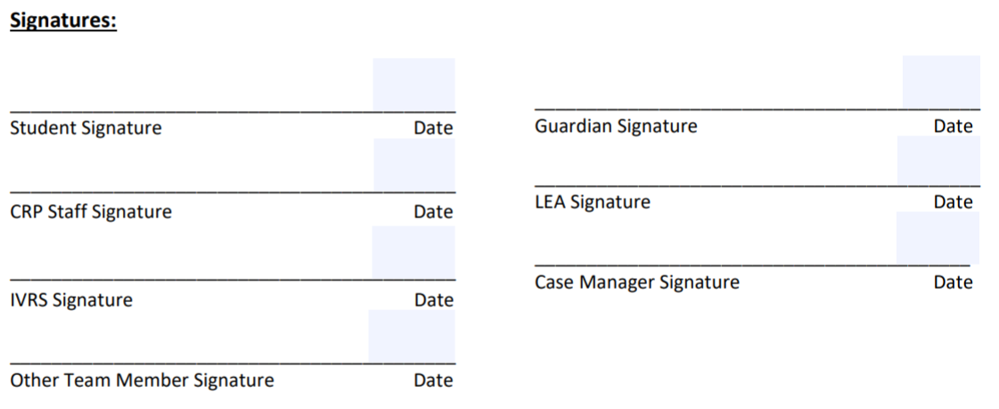
Supported Short-Term Paid Work Experience for Students

Slide 43

Payments
IVRS’s Fees for Services
1 unit = 15 minutes
Less than 50% of a unit, then round down
50% or more than a unit, then round up
Example:
If a service is for 22 minutes, that would be equal to 1 unit. If the service is for 23 minutes, that would be equal to 2 units.

Slide 44
Payments
The following are some examples that IVRS would not pay for:
intake appointments for services with the provider
provider's presence at IVRS benefits planning appointment with JC
the time it took for the service provider to call a JC to set up an appointment
the time it took for the provider to send an email or leave a voice message to update IVRS
the time it took for the provider to drive out to the JC's home without calling to ensure that the JC is able to meet
the time it took for the provider to write service reports for IVRS
team meetings with IVRS to go over cases

Slide 45

Direct Services in a virtual world...
Example of a job development claim:
1/5/2021 8am-8:04am Texted back and forth with JC to pep JC up for job interview with Casey’s.
1/8/2021 10am Emailed JC with employer login information so that JC could turn in application with Cattel and wished him luck.
1/11/2021 10:45am Texted JC inspirational words to encourage & pep JC up for interview with Cattel at 11am.
1/15/2021 1pm Congratulated JC for getting job at Cattel & agreed to meet on 1/16/2021 at 9am.
Reasonable to group those transactions together when they warrant it.

Slide 46

Dates
No contracts with CRPs to provide services on IVRS’s Menu of Service - just prior authorization from VR staff before services start.
Bill within 45 days after a service has been provided.
Signed VR authorization + appropriately completed documentation = $$$$$$$$$
State issues payments within 10 days

Slide 47

The end...
Reminder
Forms assist with the process and gathering information, they are NOT the process
Guidelines are set in place by IVRS and RSA however the JC, IVRS and the CRP relationship drives the process
Services and procedures are individualized to meet the needs of the individuals served
Documentation must be in the case file to show the story of the IVRS case file and are there not only to benefit IVRS but also the individuals served.

