Slide 1

Rapid Response
Worker Information Meeting

Slide 2

Agenda
Overview Resources and Services Available
Review Unemployment Process and Requirements
Learn about Title I Adult Dislocated Worker Opportunities

Slide 3
Department of Health and Human Services
SNAP
FIP
Medicaid
Childcare Assistance
HHS Home Page: www.dhs.iowa.gov
Phone Application for Medical: 855-889-7985
HHS Help Line: 515-725-2755

Slide 4
Employer Benefits Security Administration
Health Insurance Options
Retirement Plan
COBRA
Coverage through a Government Program
Spouse's Insurance
Individual Health Coverage
  Marketplace Information HealthCare.gov
  1-800-318-2596
Know the Details of Your Plan
Keep Your Plan Informed of Changes
Typical Retirment Age is 65
  This can be different depending on plan
EBSA Benefits Advisors: askebsa.dol.gov | 1-866-444-3272

Slide 5
One – Stop Services
Veteran Services
Career Planning
Registered Apprenticeship Program
Office Proficiency Assessment (OPAC)
National Career Readiness Certificate (NCRC)
Job Readiness Workshops
Hiring Events
Unemployment Services

Slide 6
IowaWORKS Partners
Iowa Workforce Development
Workforce Training Academy
Iowa Vocational Rehabilitation Services (IVRS)
AARP's Senior Worker Program (SCSEP)
Title 1 Adult and Dislocated Worker
Adult Basic Education – HiSET/ELL

Slide 7
Title II – DMACC HiSET & ELL
DMACC offers free HiSET (High School Equivalency Test)
  Series of five tests, taken one at a time, covering writing, science, math, literature, arts, and social studies
  Classes are held several times per week over a 6-week cycle and attendance is mandatory
DMACC offers free English Language Learner Classes
  Classes consist of multi-level English instruction for anyone over 18 years of age
  Classes fill up quickly with the next registration starting on Monday, July 28 at 8am

Slide 8
Career Development Services
Career Exploration
Career Planning
Job Search Assistance
Mock Interviews
Labor Market Information
Resume and Cover Letter Assistance
WWW.IOWAWORKS.GOV

Slide 9
Veterans Priority of Service
First access to apply for new jobs posted to the IowaWORKS Job Board
Computers reserved at IowaWORKS for veterans to utilize
Spots are saved for veterans when resources are limited
First access to employers at career fairs is reserved for veterans

Slide 10
Veteran Services
Individual employment plan
Military occupational skill translation
Interest inventory assessment
Individual career guidance and coaching
Referrals to veteran-specific supportive services

Slide 11
Central IowaWORKSLocations
Des Moines: 200 Army Post Rd. Ste 44
515-281-9619
525 SW Fifth St
515-725-3601
desmoinesiowaworks@iwd.iowa.gov
Ames: 819 Wheeler St. Ste 6, (IVRS Office)
Every Other Wednesday, 9:30am - 12:30pm, 1:30pm - 3:30pm

Slide 12

Unemployment Insurance Information

Slide 13
Unemployment Program Overview
Unemployment Insurance (UI) Requirements
How to Apply
After Applying
Questions

Slide 14
Unemployment Insurance Requirements
Meet monetary eligibility requirements
Loss of work due to no fault of your own
Be able and available for work
Verify your identity with ID.me
Actively seek work
Read the Claimant Handbook
File weekly UI claims

Slide 15
How to Apply for UI
Apply on or following your last day of work
Before you apply have:
  Social Security Number
  Recent employer name, address, and phone number
  Start and end dates of recent job
  Know if you will be receiving vacation or severance pay
Go to WWW.IOWAWORKS.GOV to apply

Slide 16
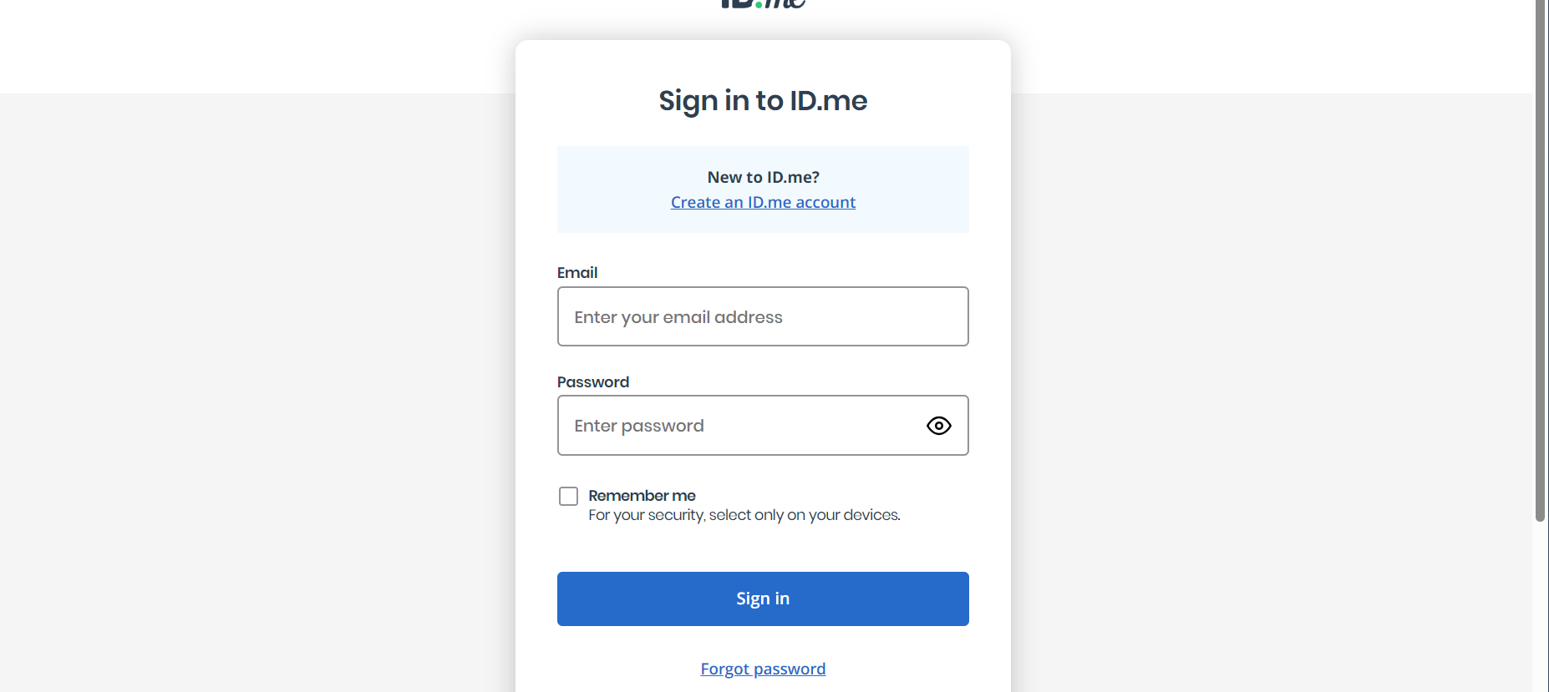
Identity Verification
If you have an ID.me account, sign in using existing username and password
If you do not have an ID.me account, select "Create an ID.me account"

Slide 17
After Applying
Monetary Record will appear in your IowaWORKS account
If mistakes appear on the Monetary Record, immediately contact the Unemployment Insurance Service Center at 866-239-0843
Watch your mail, email, system messages, and answer all phone calls while on unemployment
Be sure to indicate correspondence through internal message & email in the IowaWORKS system
Payments are typically issued 2-3 weeks after applying
Create or upload your resume in IowaWORKS
After a few weeks on unemployment, you will be assigned a Re-employment Case Manager
  Pay attention to any activities they assign you to complete to continue your unemployment

Slide 18
After Applying Continued
Every week:
You are required to apply for 4 jobs or 3 jobs and 1 reemployment activity every week
Log your job contacts and reemployment activities in IowaWORKS.gov
File your weekly claim in IowaWORKS.gov

Slide 19
Reemployment Activities
Interview for a job
Attend any IowaWORKS workshops
Attend an IowaWORKS career fair or hiring event
Attend a one-on-one career planning appointment with a Career Planner
Participate in a mock interview

Slide 20
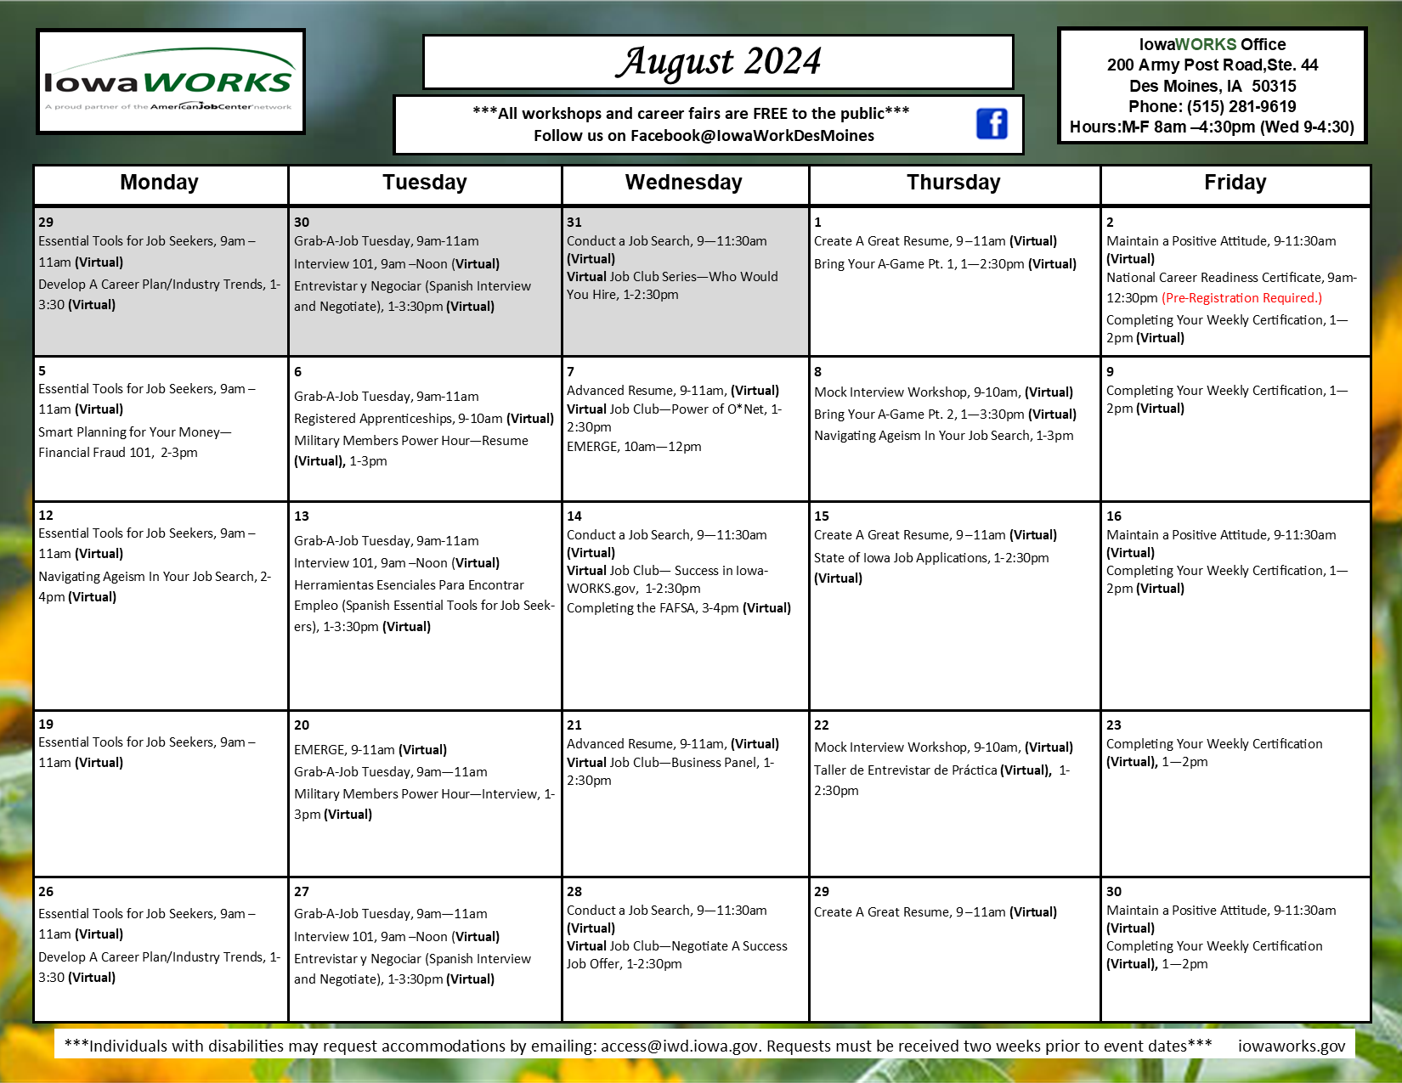
Workshop Registration
Log into IowaWORKS.gov
Select Events Calendar
Select the workshop you would like to attend
Click register

Slide 21
Unemployment Contact Information
Phone: 866-239-0843
Email: uiclaimshelp@iwd.iowa.gov

Slide 22
Title I – Dislocated Worker Program

Slide 23
Dislocated Worker Surveys
A Dislocated Worker Survey was sent to HR to complete with a link.
DW Surveys are a tool that helps IowaWORKS to connect dislocated employees with new potential employers or job opportunities and allows staff to better serve you and your impacted co-workers.
Completing the survey requires you to create an IowaWORKS account which makes applying for Unemployment benefits quicker & easier.
All information is strictly confidential. Results will only be used for re-employment, re-training, assistance, and research purposes.

Slide 24
WIOA Education and Training Services (Title I)
Provide 1-on-1 Case Management Services to Dislocated Workers
Goal: Support you in your next career goal
Dislocated Workers (DW)
  18+ years
  Citizen, Permanent Resident or Work Permit of US
  Loss of job/no-fault
  Unlikely to return

Slide 25
How We Help
One-on-one career exploration
Developing short-term and long-term goals
Developing a career pathway plan designed for you
12 months of follow-up services

Slide 26
Where We Focus
Work-Based Learning
  On-the-Job Training (OJT)
  Apprenticeships
Education
  Short-Term Certificate Programs
  College & University Degree Programs (Bachelors/Associates)
Self-Sufficiency Skills
Supportive Services

Slide 27
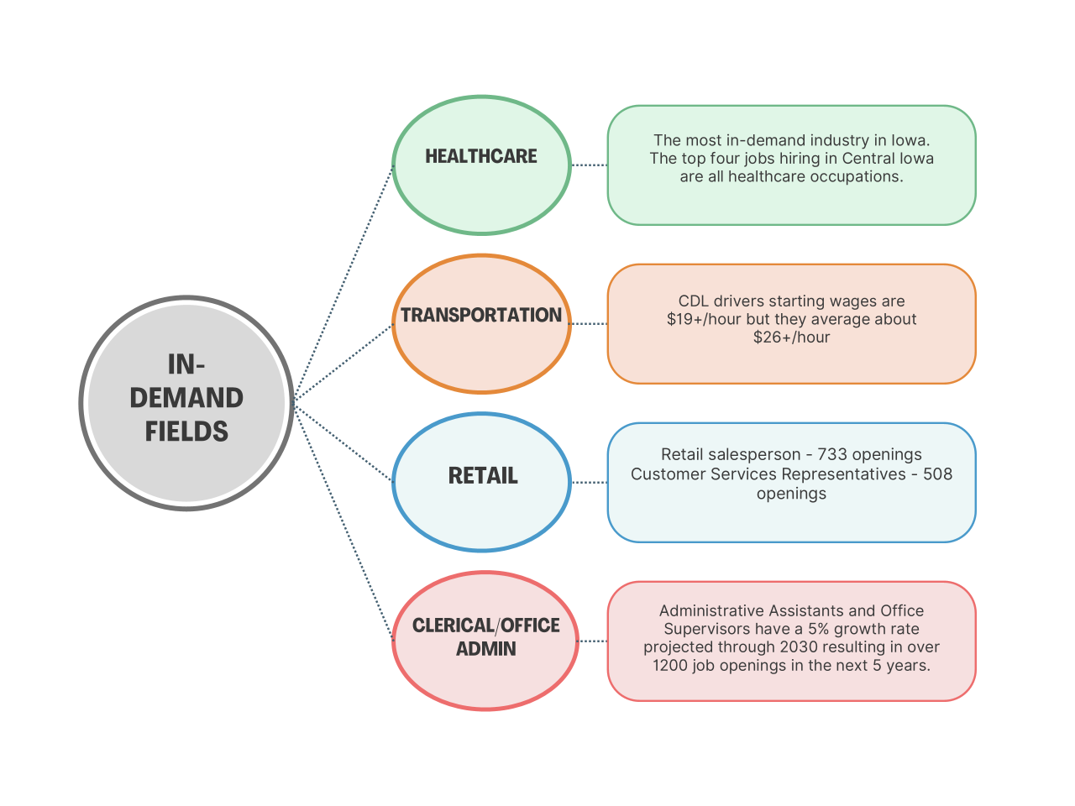
Central Iowa Local Area In-Demand
Career Fields
Career Pathways

Slide 28
Eligibility
All Participants must provide:
  State or Government Issued ID
  SS Card or Birth Certificate
  Selective Service (Males Born 1960 or Later)
  DD-214 (Veterans)
  Letter of Dislocation from Employer

Slide 29
Enrollment Process
Info Session + Application
Assessments + ONET
Enrollment Paperwork + Eligibility Documents
Plan for a minimum of 2 weeks and up to 3 appointments

Slide 30
Next Steps
You will hear from Title I when they are scheduling an info session

Slide 31
IowaWORKS
Connect 2 Careers Program
200 Army Post Road, Des Moines, IA 50315
Heather Brooks, Program Director
WIOA Title I Adult and Dislocated Worker
515-537-5839
Hbrooks@nationalable.org
Questions or Comments?

