Slide 1
Community Employment
Let’s talk about work!
Amy Desenberg-Wines & Jessica Kreho
Iowa Coalition for Integration & Employment
Lee Ann Russo
Iowa Vocational Rehabilitation Services

Slide 2
Why we are we talking today about work?
Everyone participating today has a job and that job is giving you good work experience.
Depending on your job, you can make different wages. In Iowa, the minimum wage for work = $7.25/hour.
Some people work in jobs that pay less than minimum wage. There is a new law that requires that anyone who makes less than minimum wage have the opportunity to get information and resources that provides them with different work options, including jobs in the community that pay at least minimum wage.
We want to talk with you about some things to think about to help you decide what work option is best for you!

Slide 3
Why Work?
To Help Others
Independence
Choice
Money
To Learn & Grow
Success & Accomplishment
To be Creative

Slide 4
Do you know and understand your choices around work?
Choices

Slide 5
I want to consider a new job in the community
I would like to keep my current job, but maybe have a job in the community too
I am not sure…
I think I need more time to explore before deciding
I know I don’t want to work in the community…

Slide 6
Kyle Stumpf
http://www.idaction.org/videos/?video=41

Slide 7
Some things to begin to think about work…
How long have you been working?
Have you had the opportunity to do different jobs?
How long have you been doing your current job?
What are things you like about your work?
Is there anything you don’t like about your work?
Have you ever thought about working in a different job?
If so, what kind of job/s have you thought about working in?

Slide 8
More things to think about…
What do you enjoy?
What do you do in your free time?
What are some things you are good at?
Are there things you really don’t like?
Is there anything that is hard for you?
Do you wish you had more money?
If so, what would you want to do with it?

Slide 9
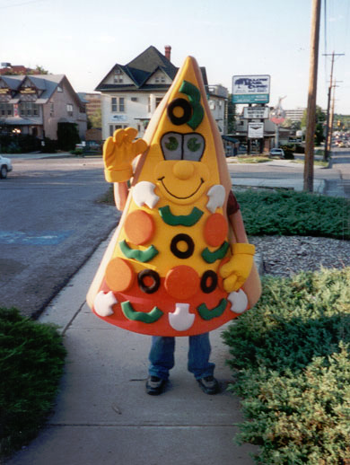
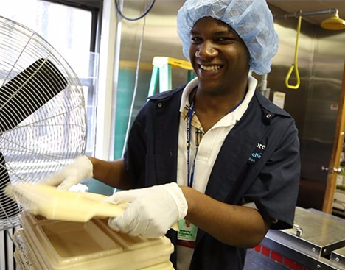
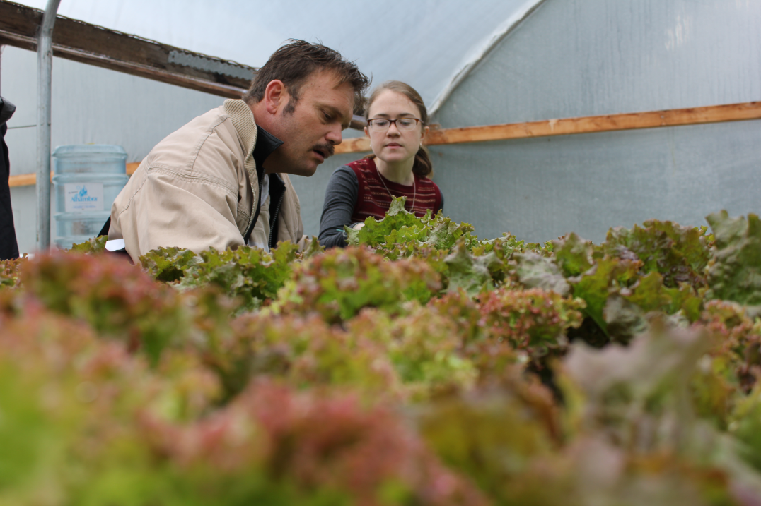
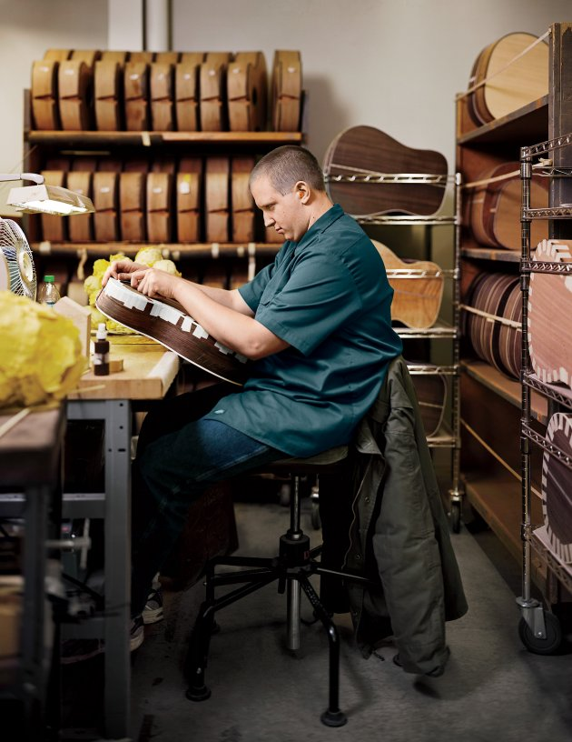
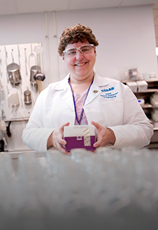
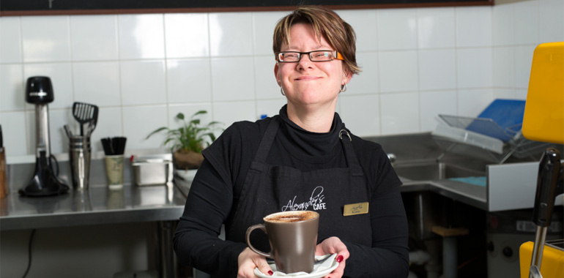
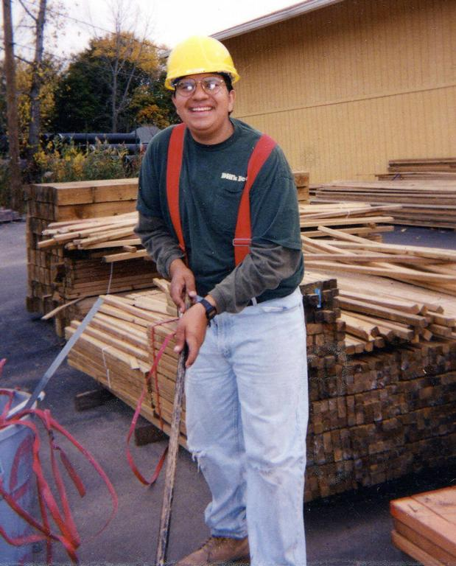
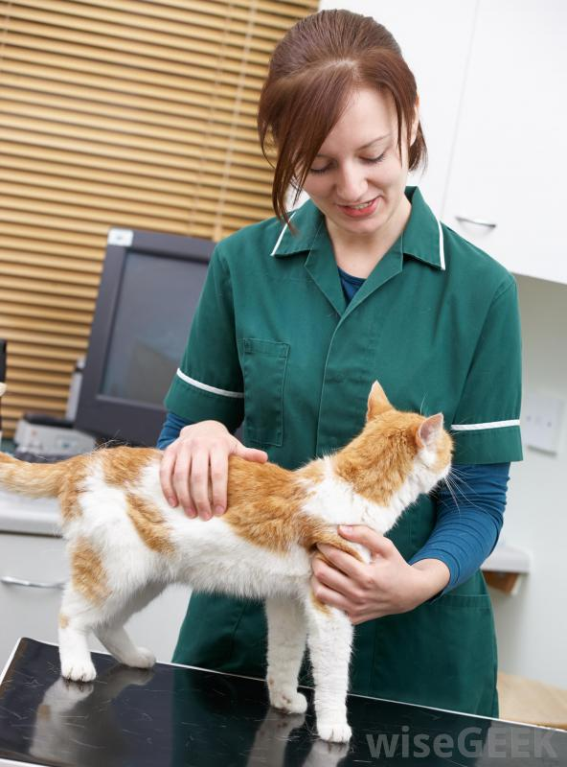
Different Types of Work

Slide 10
Working in an office on a computer
Working sorting & delivering mail
Working using a phone

Slide 11
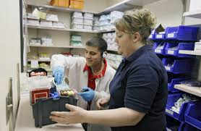
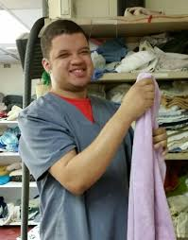
Working in a medical or pharmacy setting
Working in a retail store helping customers & working with merchandise
Working in a grocery store at the register, placing groceries on shelves, bagging, or helping with carts

Slide 12
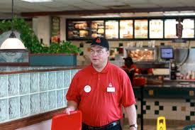
Working preparing food
Working in service & with customers

Slide 13
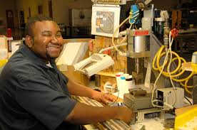
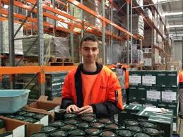
Working with machines
Working with tools
Working in a warehouse

Slide 14
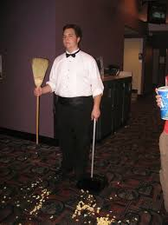
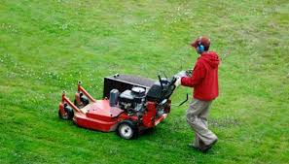
Working with animals
Working cleaning a theatre or other businesses
Working outside

Slide 15
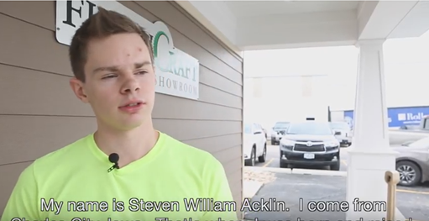
Steve Acklin
https://www.youtube.com/watch?v=0noW7GvtJJ4

Slide 16
Common Concerns…
Leaving your current job and co-workers
Maybe you aren’t sure what job you want to do
You might be wondering who will hire you
You might be afraid of losing your disability benefits
Concerned about learning new skills or tasks
Worried about meeting new people and making new friends
Wonder how you will get to work
Who will support you on the job if you need it
What if it doesn’t work out

Slide 17
SUPPORT
FOR GETTING
& KEEPING
A
COMMUNITY
JOB
CAREER EXPLORATION
DISCOVERY
ON-THE-JOB TRAINING
VOLUNTEERING
CUSTOMIZED EMPLOYMENT
SUPPORTED EMPLOYMENT
EMPLOYER NEEDS
JOB COACH
ASSISTIVE TECHNOLOGY
SKILLS TRAINING
BENEFITS PLANNING
LABOR MARKET INFORMATION

Slide 18
Making Decisions
We have opportunities to make decisions every day, and sometimes, we ask others for help with making decisions. Think about the people who may be able to help you make decisions. You don’t have to figure all of this out alone!

Slide 19
Who can help?
Family, Friends & Neighbors
Case Managers or Care Coordinators
Iowa Vocational Rehabilitation Services
Iowa Department For The Blind
Service Providers
Iowa Independent Living Centers
Iowa Workforce Development

Slide 20
https://www.youtube.com/watch?v=E472VHioGJ4&list=PLY5uHmHJUwvDzPtLn2HPig4l2u7uJ1hsu

Slide 21
So begin to think about… Do you want a job in the community?

Slide 22
WHAT’S NEXT?
Start with a conversation
Ask questions & get information
Explore & try some new things…
Don’t let fear get in your way
Take advantage of the resources & referral information shared with you
Talk about what you want in a job
Consider your options
Decide what’s best for you!

Slide 23
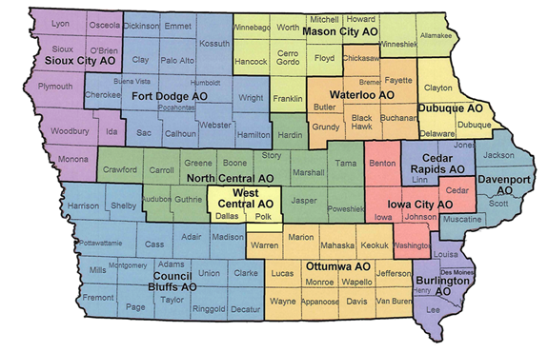
Iowa Vocational Rehabilitation Services
If you are interested in working in the community or would like some support in exploring community job options, contact IVRS.
1-800-532-1486 (Toll Free) or
515-281-4211 V/TTY
http://www.ivrs.iowa.gov/ContactUs/maincontact.html

Slide 24
Questions? Contact us…
Amy Desenberg-Wines Iowa Coalition for Integration & Employment | Phone 515-981-4113 adesenbergwines@gmail.com
Jessica Kreho Iowa Coalition for Integration & Employment | Phone 515-250-9803 pruittjess@gmail.com
Lee Ann Russo Iowa Vocational Rehabilitation Services | Phone 515-281-4144 Leeann.Russo@iowa.gov

Slide 25
Marissa Schletzbaum
http://www.idaction.org/videos/?video=40
* Interested in checking out more Iowa employment stories, go to IDAction - http://www.idaction.org/videos/
and select videos with NDEAM (National Disability Employment Awareness Month) in the title.

