Slide 1
Benefits Planning Community of Practice
July 8, 2019

Slide 2
What is Benefits Planning?
Benefits Planning helps Social Security disability (SSI/SSDI) beneficiaries understand the impact of work on their benefits.
Benefits Planning includes exploring and utilizing work incentives and developing a plan to transition to work.
Benefits Planners:
Explain how all of a person’s benefits will be affected if they go to work;
Give a written report that shows how earnings from employment will change a person’s benefits;
Tell people about other community services that can help them;
Be available to answer any questions about benefits, even after a person goes to work;
Provide ongoing benefits management, which can include a new analysis if a person gets a raise; and
Make a referral to help you resolve any legal barriers related to employment, such as employer accommodations that will help a person do their job.

Slide 3
Why is Benefits Planning Critical?
There are 115,945 Iowans receiving Social Security disability cash benefits
There are 44 Employment Networks participating in Ticket to Work (most of these have a benefits planner on staff)
There are 2 WIPA CWICs
Less than half of 1% of the 115,945 beneficiaries are engaged with either VR or an Employment Network
111,103 Iowans could likely benefit from benefits planning services
There are not enough benefits planners to serve all of the individuals who could benefit!

Slide 4
The Most Important Message:
People with disabilities can work!
It is important to remember these facts about benefits planning, working, and receiving Social Security benefits:
It is possible to work and keep Medicaid or Medicare in almost every case
It is possible to work and come out ahead financially even if benefits are reduced
It is possible to receive disability benefits again if they are lost due to employment
Benefits planning is not intended to force anyone off benefits, nor is it intended to help people maximize their benefits

Slide 5
What is the Community of Practice?
Monthly webinars on a different topic related to benefits planning
A way for professionals providing benefits planning services to share resources and information and ask questions
A way to build capacity for benefits planning in Iowa
Available for all professionals providing employment supports to individuals with disabilities

Slide 6
What is the Benefits Planning Community of Practice?
Email Group
Monthly webinars
IABenefitsPlanning@iwd.iowa.gov
60-90 minutes in length
Focused on a benefits planning topic
No cost to participate
Recorded and archived

Slide 7
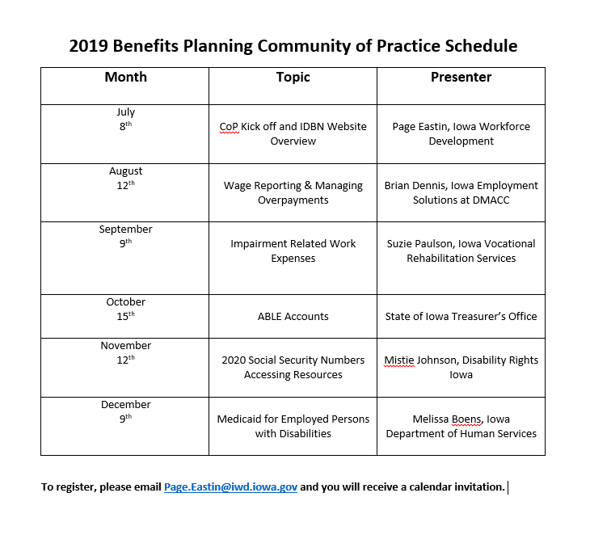

Slide 8
Benefits Planning Website
Developed by a group of state and community partner agencies
Provides information for:
Individuals with Disabilities and Families
Youth with Disabilities
Professionals
www.DisabilityBenefits.Iowa.Gov

