Slide 1
CEO Office Hours
Adult and Dislocated Worker Service Provider RFP

Slide 2
Today’s Presenter
Michelle McNertney
  Michelle.mcnertney@iwd.iowa.gov

Slide 3
Purpose of Office Hours
To provide an opportunity for Chief Elected Officials (CEOs) to
  Ask questions and seek clarification regarding their tasks within the Iowa workforce system transformation
  Engage in dialogue with other CEOs and Iowa Workforce Development
To provide an opportunity for Iowa Workforce Development to
  Provide guidance or explanation on policies

Slide 4
Objectives of Office Hours
Review Upcoming Trainings and Dates
Answer Any Questions about PY20 Allotment emails sent 7/9/2020

Slide 5
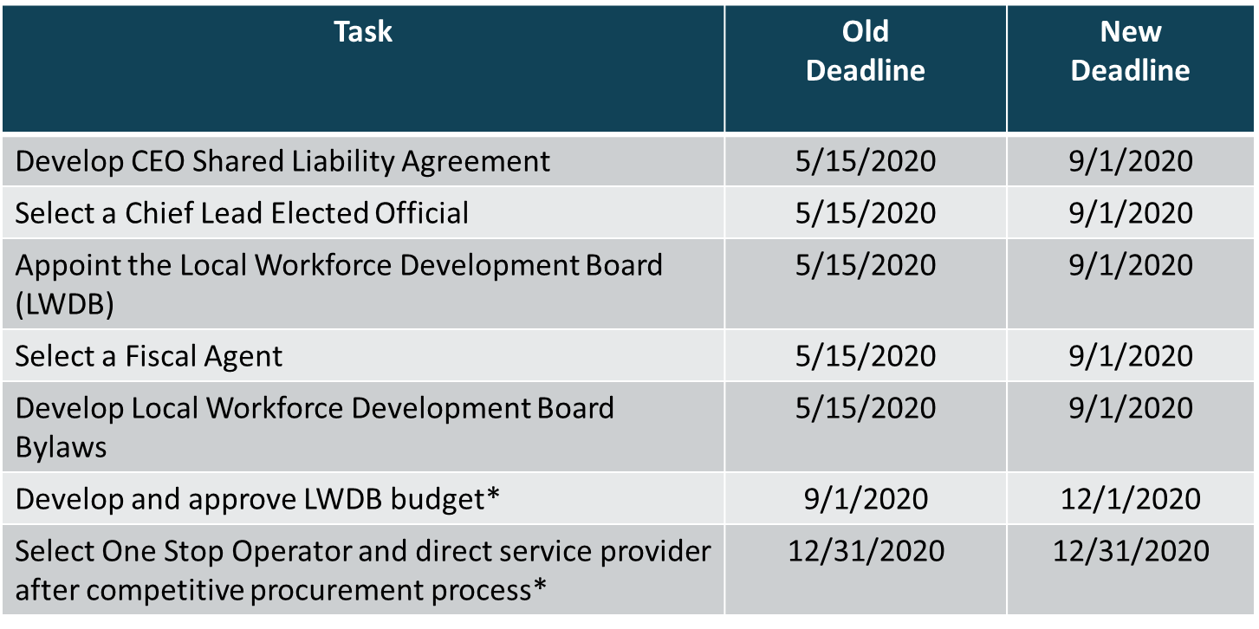
CEO Key Deliverables/ Revised Timeline

Slide 6
Upcoming Training Information (all Virtual)
Fiscal Agent
Training
September 16, 2020
10:00 am – 2:00 pm with 30 min lunch break
Last week of Sept. / First week of Oct.
10:00 am – 2:00 pm with 30 min lunch
1 Training session per LWDB
LWDB members and staff only
Local Board
Training

Slide 7
Questions about Insurance
Example Language from CEO Shared Liability Agreement – is this an allowable cost?
The Parties of this Agreement agree that the LWDB shall purchase such insurance as is necessary to fully insure the Chief Elected Official Board and indemnify its member counties, their elected officials or designees and the signatories to this Agreement and save them harmless from all suits, actions, damages, liability and expense in connection with any misuse of grant funds allocated to the local area under sections 128 and 133 of the Workforce Innovation and Opportunity Act arising wholly or in part by any act or omission of the Chief Elected Official Board, the LWDB or any of its members, the fiscal agent or any of its members, their agents, contractors, employees, servants, invitees, licensees or concessionaires, and from all reasonable attorney’s fees and other costs of defending any such suit or action. Insurance policies to be purchased and maintained shall name LWDB and the Chief Elected Official Board members as insureds, and shall include, but not be limited to, coverage for directors’ and officers’ liability, crimes committed, professional liability, general liability, sexual abuse, worker’s compensation, automobile and fiduciaries liability.
Answer - WIOA can pay for “Directors & Officers” liability coverage that will cover a variety of issues; lawsuits, etc. However, most policies do not cover them if they are found to intentionally to violate the rules. But it is an allowable cost and should be allocated among all funding sources.

Slide 8
Who has the Right to Hire Staff to the Board?
Per WIOA, 20 CFR 679.400, it is the Local Workforce Development Board that has the right to hire staff to the Board, not the CEOs.

Slide 9
Questions?

Slide 10
Contact
      WIOAgovernance@iwd.iowa.gov
      Michelle.mcnertney@iwd.iowa.gov
      Linda.rouse@iwd.iowa.gov
      Michael.witt@iwd.iowa.gov

Slide 11
Next Office Hours
Friday, July 24
12:00 pm

Slide 12
Thank You!

