Slide 1
CEO Office Hours

Slide 2
Today’s Presenter
Michelle McNertney
  Michelle.mcnertney@iwd.iowa.gov

Slide 3
Purpose of Office Hours
To provide an opportunity for Chief Elected Officials (CEOs) to
  Ask questions and seek clarification regarding their tasks within the Iowa workforce system transformation
  Engage in dialogue with other CEOs and Iowa Workforce Development
To provide an opportunity for Iowa Workforce Development to
  Provide guidance or explanation on policies

Slide 4
Objectives of Office Hours
General Questions

Slide 5
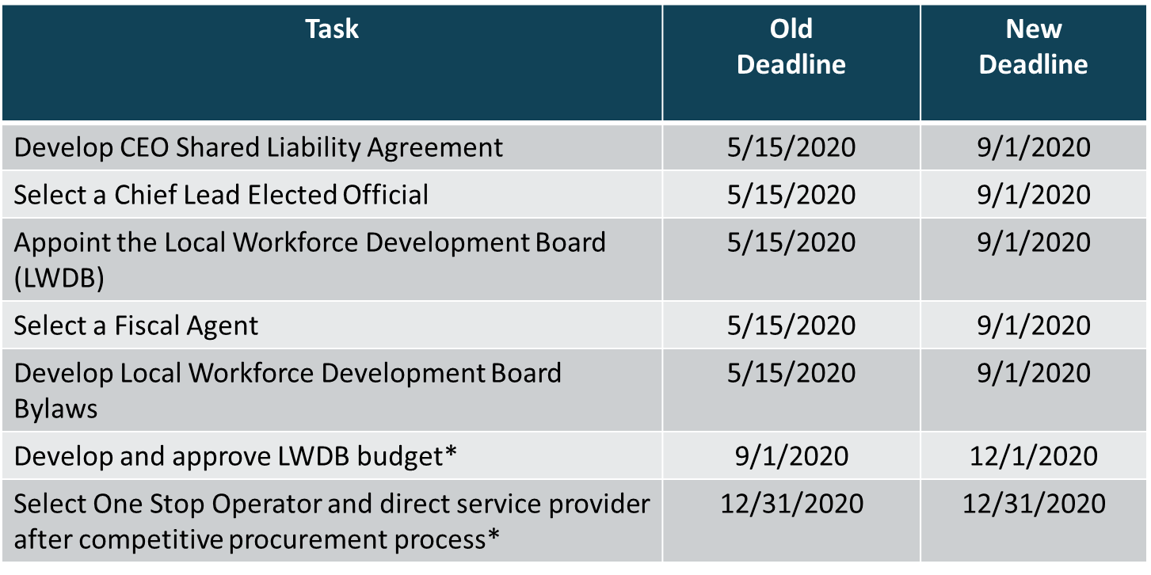
CEO Key Deliverables/ Revised Timeline

Slide 6
Questions?

Slide 7
Contact
      WIOAgovernance@iwd.iowa.gov
      Michelle.mcnertney@iwd.iowa.gov
      Linda.rouse@iwd.iowa.gov
      Michael.witt@iwd.iowa.gov

Slide 8
Next Office Hours
Friday, August 7
12:00 pm

Slide 9
Thank You!

