Slide 1
Iowa
Blueprint
for Change
DISABILITY INNOVATION FUND
The contents of this presentation were developed under grant number H421D220013 from the Department of Education. However, these contents do not necessarily represent the policy of the Department of Education, and you should not assume endorsement by the Federal Government. (Authority 20 U.S.C. §§ 1221e-3 and 3474)
Notes:
Welcome and thank you for your interest in the Disability Innovation Fund Iowa Blueprint for Change project. In this presentation, we will go through how the DIF program has been built into IRSS and provide instructions on how you will add participants and the associated data in the system that is needed to evaluate the program. Let’s get started.

Slide 2
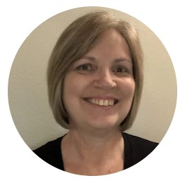
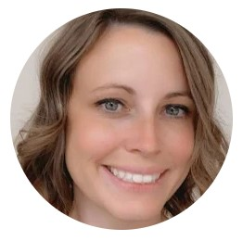
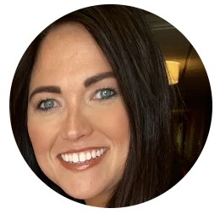
VR DIF Team
Sandy Ostendorf
Brandy McOmber
Vienna Hoang
IRSS Trainer
CRP Resource Manager
DIF Director
Ashley Banes
Paul Fuller
Michelle Krefft
DIF Counselor Specialist
DIF Counselor Specialist
Community & Business Engagement Director
Notes:
The team that helped develop the program in IRSS includes:
Sandy Ostendorf, Management Analyst 3 and IRSS Trainer. 10% of my time was written into the DIF project.
Brandy McOmber, Program Manager and DIF Director.
Vienna Hoang, CRP Resource Manager. 20% of Vienna’s time was written into the DIF project.
Ashley Bankes, DIF Counselor Specialist. Ashley will generally cover DIF activities and initiatives in the southern half of the state.
Paul Fuller, DIF Counselor Specialist. Paul will generally cover DIF activities and initiatives in the northern half of the state.
Although not involved in the IRSS aspects of DIF, Michelle Krefft is also involved in the DIF initiative business services; and there are two positions that are vacant that will get folded in when the positions are filled. These include the Benefits Planning Resource Manager and Assistive Technology Counselor Specialist.

Slide 3
What is DIF?
The Disability Innovation Fund is a grant opportunity provided by the Rehabilitation Services Administration with the intent to improve employment outcomes of individuals with disabilities.
Notes:
DIF is an acronym of Disability Innovation Fund. These are grant opportunities provided by RSA with the intent to improve CIE outcomes for individuals with disabilities. Our agency applied for and received a grant a year ago through one of the opportunities provided by RSA.

Slide 4
What is Iowa Blueprint for Change?
Iowa Blueprint for Change is the name given to our DIF initiative. The mission of the Iowa Blueprint for Change is to advance and improve systems so Iowans with disabilities have competitive integrated employment opportunities that lead to economic security.
Notes:
Iowa Blueprint for Change is the name we gave to our DIF initiative. DIF and Iowa Blueprint for Change or IBC are used interchangeably to refer to this initiative.

Slide 5
What is SWTCIE?
Specifically, the DIF grant awarded to Iowa VR is for moving individuals from Subminimum Wage To Competitive Integrated Employment (SWTCIE).
Notes:
The specific DIF we were awarded is for moving individuals from subminimum wage employment to competitive integrated employment. The acronym you may have heard for this is SWTCIE. Because it wasn’t already confusing enough, this is just another acronym that refers to this same initiative!

Slide 6
Data Needed for Performance Objectives and Performance Measures
Age Category
at Enrollment
Eligibility Criteria at Enrollment
Employment at
Case Closure
Youth (24 and Under)
Adult (25 and Older)
Validated off the JC’s date of birth and locks
Employed in Competitive Integrated Employment
Employed in Both Subminimum Wage Employment and Competitive Integrated Employment
Employed At or Above Subminimum Wage In A Non-competitive Environment
Employed in Subminimum Wage Employment Only
Not Employed
Working in Subminimum Wage Employment
Contemplating Subminimum Wage Employment
Working in Subminimum Wage Employment AND Competitive Integrated Employment
Notes:
Most of the data we need for the DIF grant is already available in IRSS. The items on this slide are not in the system so they needed to be built in.
Some may seem like they are things we already collect, but these differ from information already collected for various reasons:
In some cases we may be collecting a piece of data at a specific time that is outlined in the RSA-911, but the DIF project requirements do not match the RSA-911 requirements.
The age category we collect needs to reflect their age at DIF enrollment, so we can’t just calculate this off the JC’s DOB every time we have to report to RSA for the DIF. All participants would end up in the adult category as they age out of the youth category if we went by their DOB.
We had to establish eligibility criteria for the DIF project, so obviously that did not exist in IRSS previously.
For employment information at both enrollment and closure, we need the average number of hours worked and the average wages earned from all jobs, not just the one that the JC derives the most income from, which is what we collect for the RSA-911 requirements.

Slide 7
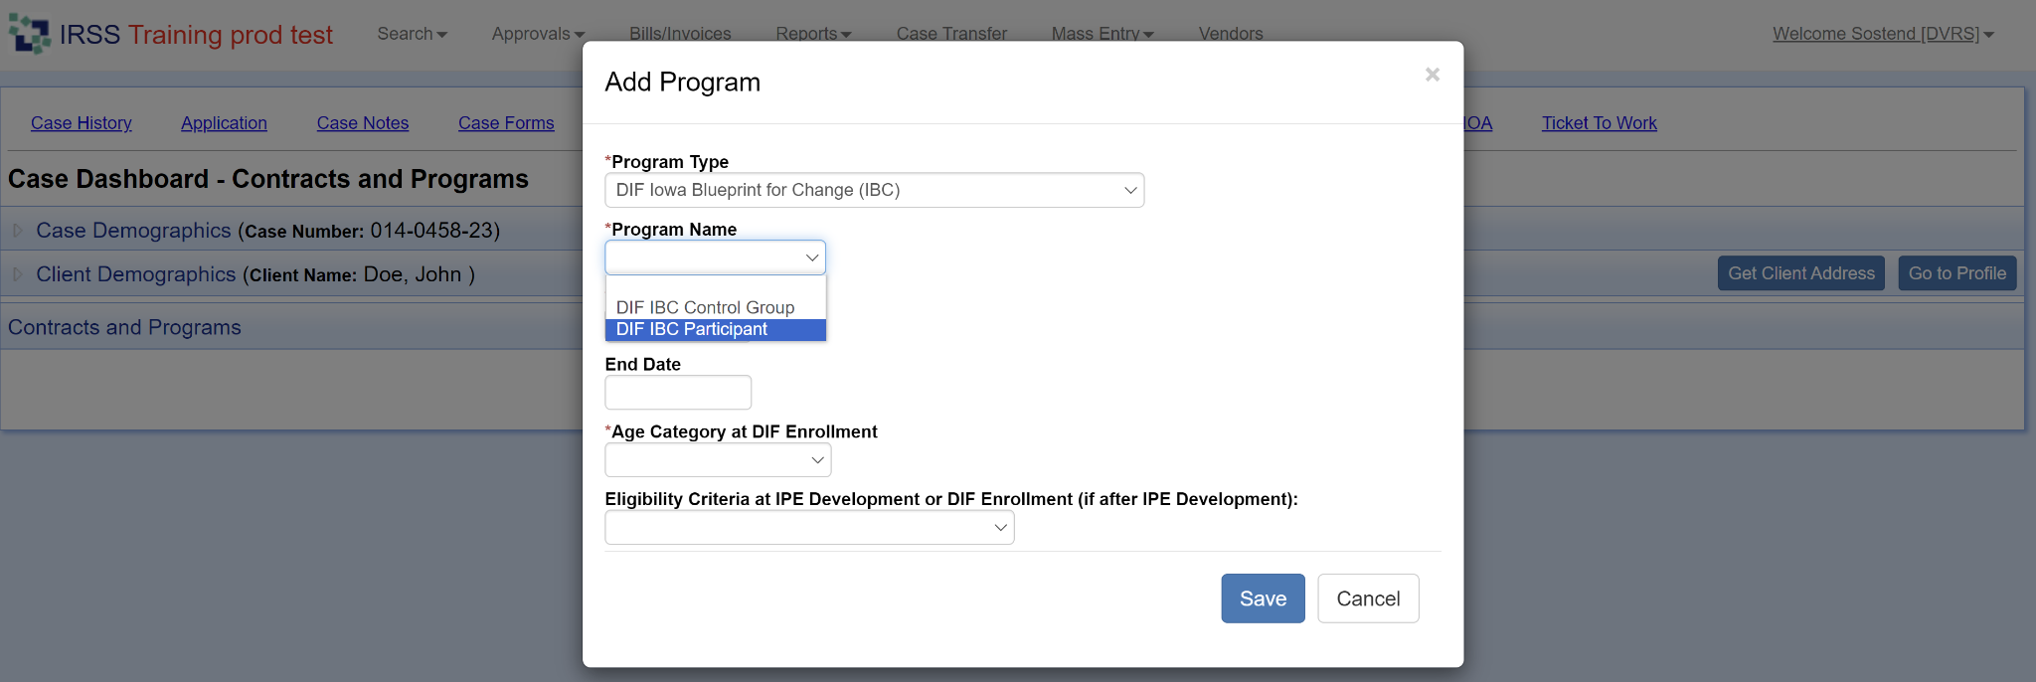
How does this look in IRSS?
Notes:
The DIF program has been added on the Programs/Contracts tab in IRSS.
The Program Type is DIF Iowa Blueprint for Change (IBC).
We have two program names: one for participants in DIF and another for the DIF control group.

Slide 8
Wait!
What’s the difference?
Participant | Control Group
A participant case is a job candidate who meets one of the qualifying criteria already discussed: Working in Subminimum Wage Employment Contemplating Subminimum Wage Employment Working in Subminimum Wage Employment AND Competitive Integrated Employment | A control group case is a job candidate who is receiving similar regular VR services and matches a set of covariates similar to participants in the control group. Covariates include: Age Gender Race Ethnicity Residency (Rural/Urban) Diagnosis Number of Functional Limitations Day Habilitation Participation
Notes:
So you may be thinking, wait, what’s the difference?! The DIF project will use evidence-based practices to hopefully show that the innovative system and service changes result in better competitive employment outcomes for individuals who have historically worked at subminimum wage, have been targeted for subminimum wage employment, or utilize day habilitation services. We cannot use a random sampling because we need to assure participants and control group cases are accessing similar services and have similar characteristics or covariates. Instead, we’ll be using what is called quasi experimental design propensity score matching, which is just a fancy name to say we’re looking for cases with similar characteristics or covariates.
Field staff add DIF participants in IRSS, then the DIF team will identify control group cases that meet the requirements for propensity score matching so we have two similar groups to compare when we evaluate for the performance measures. An example is if someone in the field adds the DIF program to a job candidate’s case and the job candidate is a 36 year old caucasian male residing in a rural setting based on their county of residence, has a mental health diagnosis, is MSD with limitations in 4 areas, we will need to try to find a job candidate who matches as many of those characteristics who does not have expanded DIF services in their area, but is receiving similar regular VR services for the control group. Because this gets complicated pretty quickly, the DIF team will choose the control group cases.

Slide 9
Triggers to add the DIF program in IRSS.
Subminimum Wage Employment
Adults Contemplating SMW Employment
High School Pilot Programs
An applicant reveals in an intake appointment that they are working in SMW employment.
A job candidate reveals at IPE development that they are working in SMW employment.
A JC on your caseload is working in SMW employment or starts working at SMW.
JC is a former Level 3 high school student and DIF services are available in your area.
JC is a day habilitation participant (any age).
JC is an adult receiving case management services that are not employment related.
JC is a current Level 3 high school student in a DIF pilot area.
JC is a high school student who receives their own SSI benefit and is in a DIF pilot area.
Notes:
You may be thinking, how will I know that I need to add the DIF program to a case? We have developed a set of triggers that you may use to determine appropriate job candidates. These have been built into IRSS as qualifying criteria.
First, anyone currently working in subminimum wage meets the qualifying criteria. You may learn about this employment status at application during the intake process or when you collect the employment at IPE data at plan development. You may have job candidates on your caseload right now who are working in subminimum wage employment and are appropriate for DIF. If that’s the case, go ahead and add the DIF program.
Next, the DIF team had to come up with a set up criteria to use for individuals who can be considered to be contemplating subminimum wage employment. For adults, we decided to use a history of Level 3 special education instruction in high school and DIF services are available in your area, current participation in day habilitation, and job candidates who are receiving case management services that are not employment related.
And finally, for high school student, we decided the contemplating criteria will include students who are currently receiving Level 3 special education instruction and students who receive their own SSI disability benefit. For this group, it will also require that we have a DIF pilot site in your area. The HS pilots will be built out in years 2-4 of the DIF which includes federal fiscal years 24, 25, and 26. We are putting out a request for information that districts can respond to which eventually will lead to an request for proposal (RFP) to identify pilot sites.

Slide 10
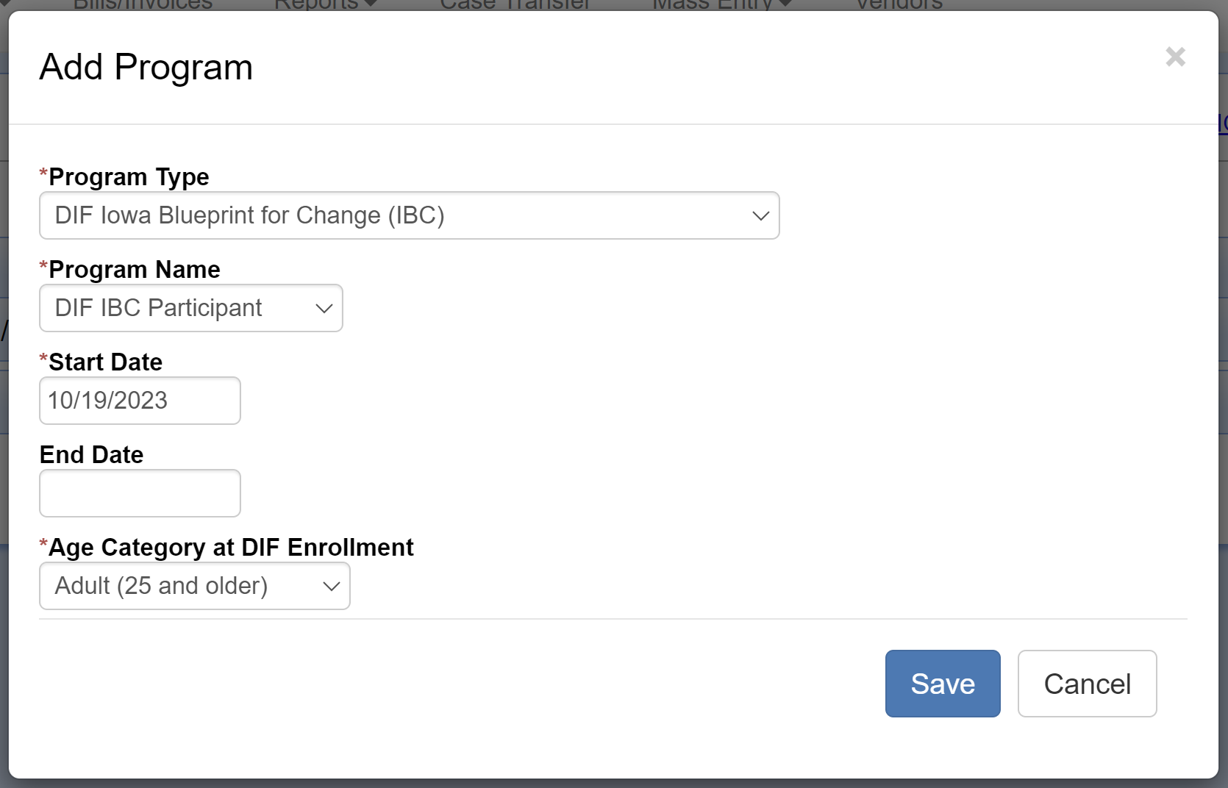
DIF at Status 02-0
When adding the program in Status 02-0, IRSS requires:
Program Type: DIF Iowa Blueprint for Change (IBC)
Program Name: DIF IBC Participant
Start Date
Age Category at DIF Enrollment
Notes:
The data IRSS will require depends on the status the case is in at the time you add the program. The program cannot be added until a case is in status 02-0 or above.
Field staff will add the DIF program to cases when the JC meets any of the qualifying criteria previously discussed.
When the case is in status 02-0, you’ll be prompted to add a program type, program name, start date, and age category.
The program type is DIF Iowa Blueprint for Change (IBC).
The program name is DIF IBC Participant.
For the age category at enrollment, if the job candidate is 24 or younger, you’ll choose Youth and if the job candidate is 25 or older, you’ll choose Adult.
IRSS validates that you have chosen the correct age category using the JC’s DOB.
Age Category at DIF Enrollment locks when you save the program and cannot be edited because that information is needed for the propensity score covariate purposes.

Slide 11
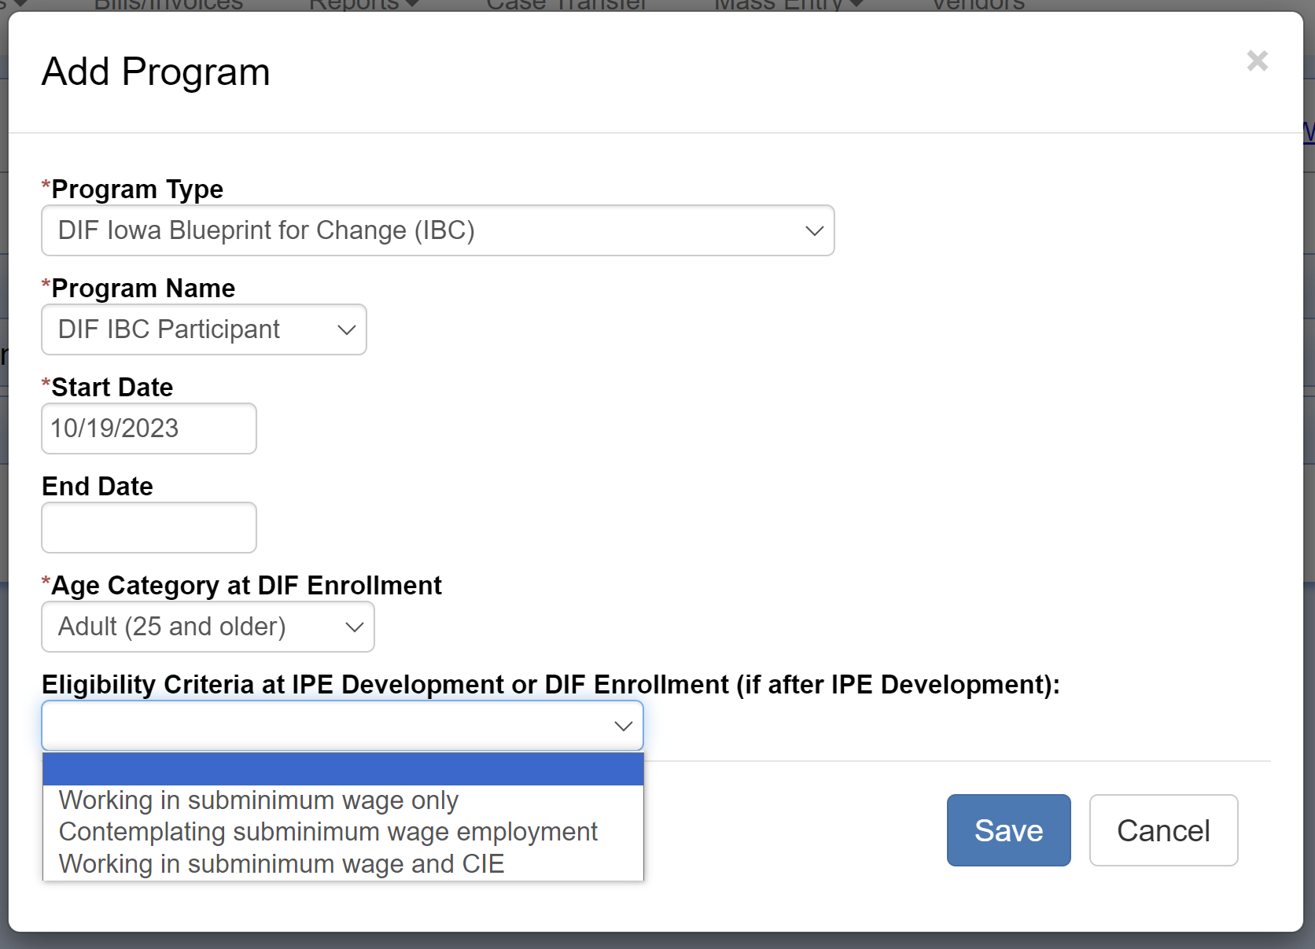
DIF at Status 10-X
When adding the program in Status 10-0 or 10-1, IRSS requires:
Program Type: DIF Iowa Blueprint for Change (IBC)
Program Name: DIF IBC Participant
Start Date
Age Category at DIF Enrollment
Eligibility Criteria at IPE Development or DIF Enrollment (if after IPE Development)
Notes:
When the case is in status 10, you’ll be prompted to add a program type, program name, start date, age category, and eligibility criteria.
The program type is DIF Iowa Blueprint for Change (IBC).
The program name is DIF IBC Participant.
For the age category at enrollment, if the job candidate is 24 or younger, you’ll choose Youth and if the job candidate is 25 or older, you’ll choose Adult with the same validation using the JC’s DOB and this will lock with the program is saved.
In the eligibility criteria section, you will choose the specific criteria your job candidate meets to be eligible for the DIF program. This field remains editable until a plan is approved in the system.
If the DIF program is added prior to a case going into status 10, an Eligibility Criteria selection will be required to approve an IPE-2 in the system.

Slide 12
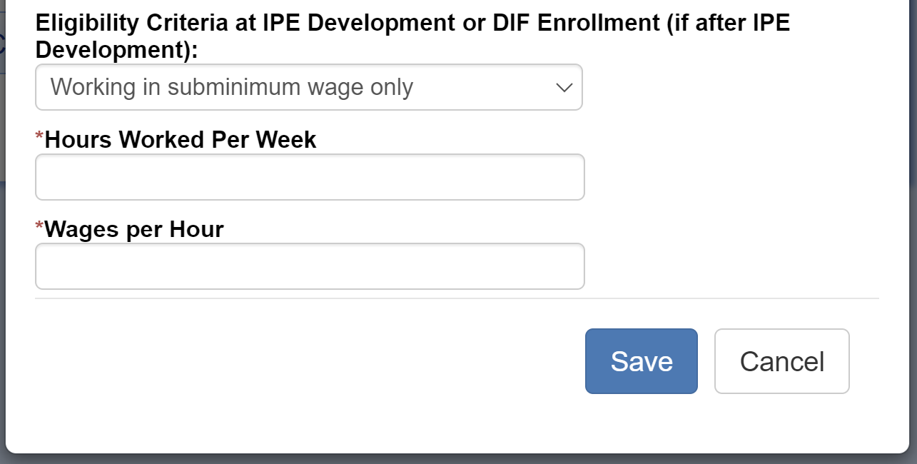
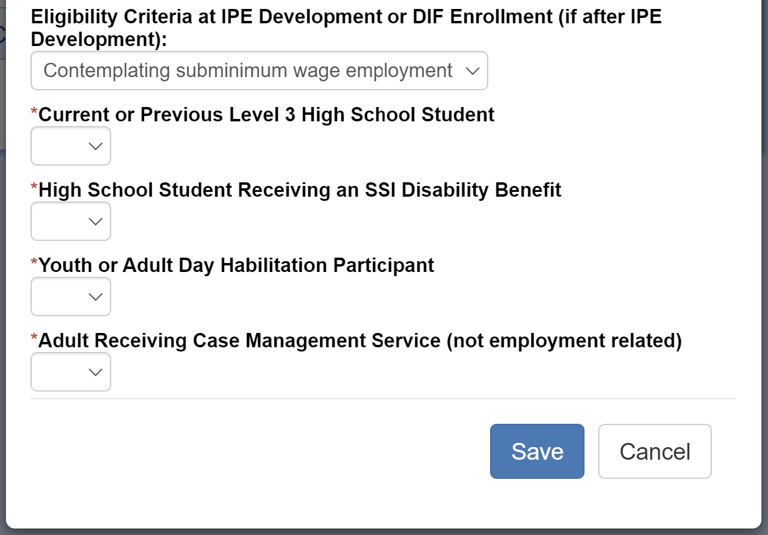
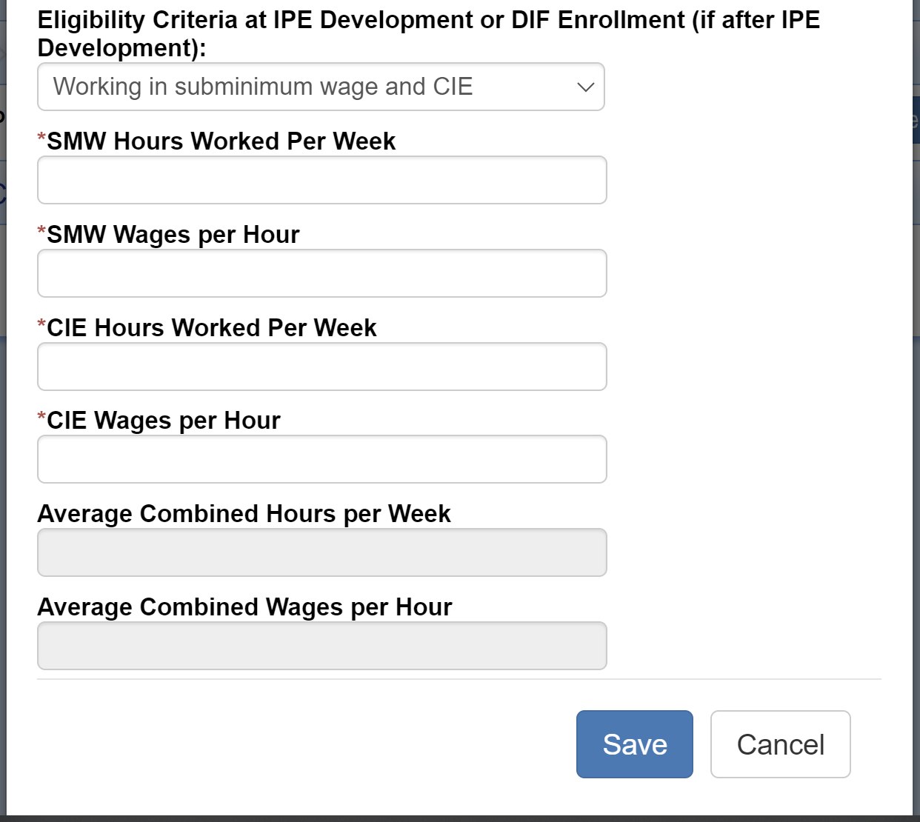
Eligibility Criteria:
1
Working at Subminimum Wage Only
2
Contemplating Subminimum Wage Employment
3
Working in Subminimum Wage and CIE
Notes:
If your job candidate is working at subminimum wage only, IRSS will require the average hours worked per week and the average wages per hour. IRSS allows anything above zero for the wages, so if your JC is receiving piece rate, you can calculate an average wage and enter the amount.
For the contemplating criteria, you job candidate must meet at least one criteria, but we want to know all options the JC meets, so you’ll need to answer Yes or No to each. Again, the contemplating criteria includes:
Current or previous level 3 high school student and the student must have a DIF high school pilot in the area and adults must have DIF services available in their area.
High School Student Receiving an SSI Disability Benefit and they have a DIF pilot in the area.
Youth or Adult Day Habilitation (Adult Day Care) Participant
Adult Receiving Case Management Services that are not employment related.
If your job candidate is working at subminimum wage AND CIE, IRSS will require the average hours worked per week and the average wages per hour in each type of employment. IRSS allows anything above zero for the SMW wages but will validate for wages equal to or over $7.25 per hour for CIE.

Slide 13
DIF at Status 14-0 or higher
When adding the program in Status 14-0 or higher, IRSS requires:
Program Type: DIF Iowa Blueprint for Change (IBC)
Program Name: DIF IBC Participant
Start Date
Age Category at DIF Enrollment
Eligibility Criteria at IPE Development or DIF Enrollment (if after IPE Development)
Notes:
When the case is in status 14 or higher, you’ll be prompted to add a program type, program name, start date, age category, and eligibility criteria.
The program type is DIF Iowa Blueprint for Change (IBC).
The program name is DIF IBC Participant.
For the age category at enrollment, if the job candidate is 24 or younger, you’ll choose Youth and if the job candidate is 25 or older, you’ll choose Adult with the same validation using the JC’s DOB and this will lock with the program is saved.
In the eligibility criteria section, you will choose the specific criteria your job candidate meets to be eligible for the DIF program.
Age Category at DIF Enrollment locks when you save the program and cannot be edited and in addition, all the eligibility criteria locks when you save the program when the case is in a service status, so you will need to have all the hour and wage information when you add the program because you won’t be able to go back in and add it later.

Slide 14
Authorizing Using DIF Funds
$
Before authorizing using the DIF service lines, make sure the DIF program is on the case.
DIF services are not to be reported on the RSA-911 as purchased services, so we’ll need to add them as a comparable service and benefit.
RSA has told us to use Other as the service provider for these.
Notes:
The next step in the process will be authorizing for appropriate VR services when we are paying someone else to provide the services. From this point forward, if you are going to use any of the DIF service categories or service lines to authorize for a service, we want you to check to make sure the DIF program is on the case prior to authorizing. This will assure the DIF grant funds are being spent only on job candidates who are considered to be DIF participants.
We are not allowed to report the services funded by DIF in our RSA-911 federal reporting so we need to enter a comparable benefit and service in IRSS when we authorize using DIF funds. These comparable benefits and services are to be reported using Other as the service provider.

Slide 15
DIF to Regular
VR Services Crosswalk
When you authorization for | Enter | Comparable Benefit & Service Category*
Customized Discovery | -> | Assessment
Customized Job Development | -> | Customized Employment/ Job Carving
Customized Employment Supports | -> | Supported Employment
IPS Career Exploration | -> | Assessment
IPS Job Development – 1 | -> | Job Search
IPS Job Development – 2 | -> | Job Search
IPS Job Coaching | -> | Supported Employment
* Use Service Provider Type “Other” for all DIF funded services
Notes:
In order to authorize for DIF services, you will add the DIF service category that matches the service being provided to your plan. In addition, you need to add the corresponding regular VR service so the comparable benefit and service can be entered as well. This table shows the crosswalk between the DIF service and the regular VR service. The table includes a couple of services that we plan to build out in IRSS soon for Customized Employment. These are not available in IRSS yet but we wanted to include them so the crosswalk includes all current DIF services and DIF services that are still in the planning phase in one handy chart.
Using this chart, as an example, when you authorize for customized discovery, you also need to add Other as a comparable benefit and service under the Assessment service category, and so on for all the other DIF services listed. Next, I’ll show you how the comparable benefits and services are added in IRSS.

Slide 16
Comparable Benefits & Services
Notes:
The comparable benefits and services are added in IRSS on the Case Services tab. To enter a comparable benefit and service, click the Add Comparable Benefits button.

Slide 17
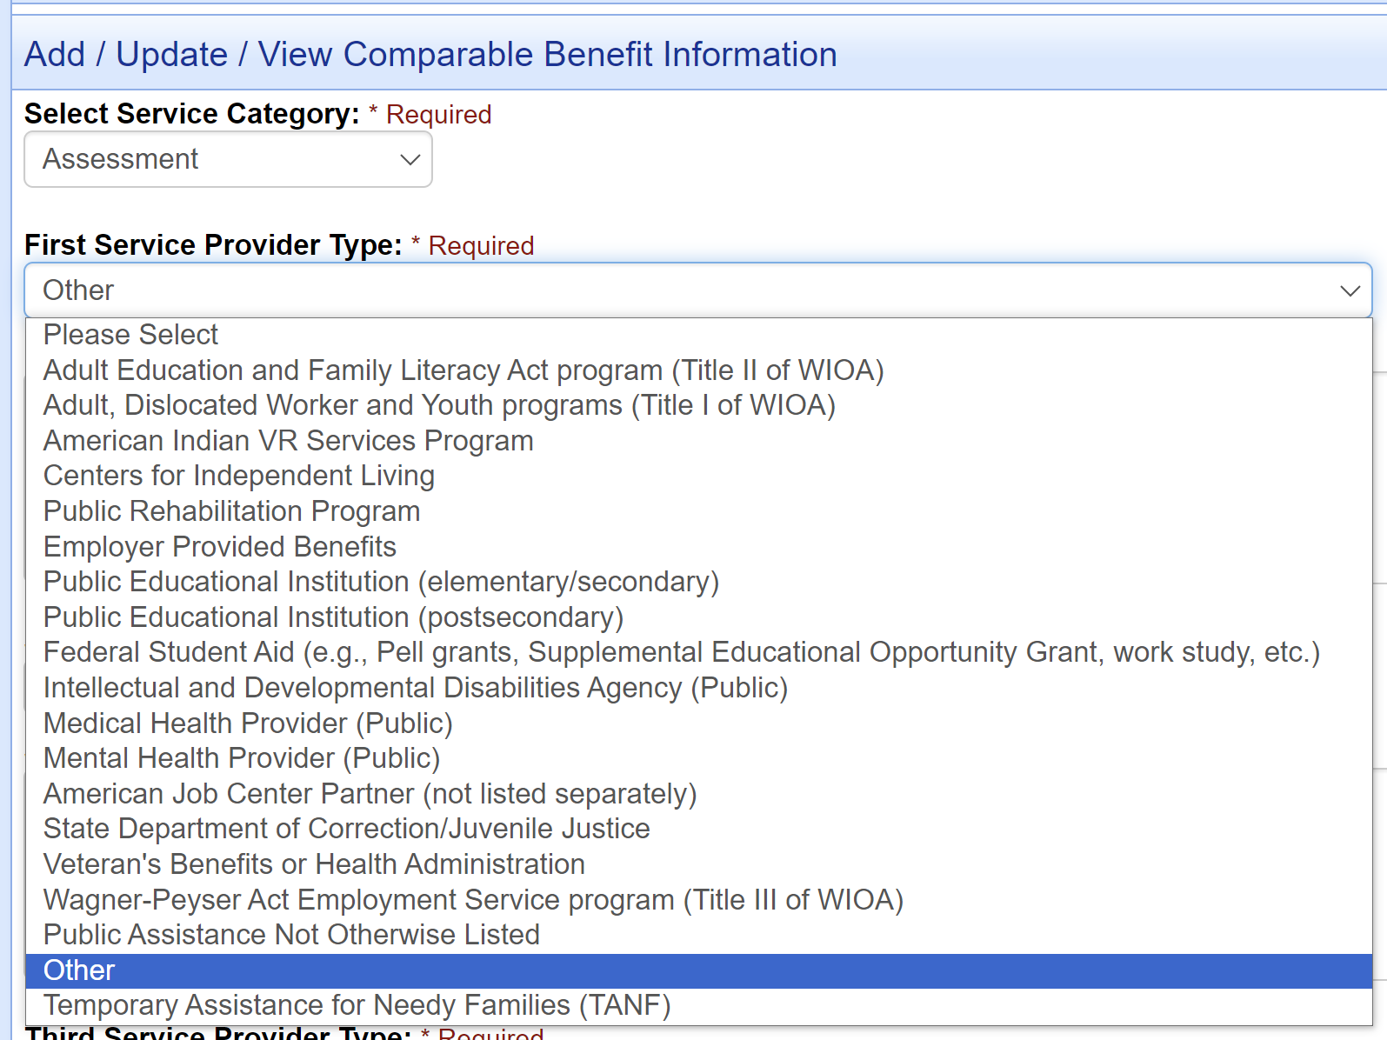
Comparable Benefits & Services
Use Other under the Service Provider Type selection to identify DIF as the funding source for all authorizations funded through the DIF grant.
Notes:
On the next screen, under Select Service Category, you’ll choose the appropriate regular VR service category based on the crosswalk chart. Then under Service Provider Type, choose Other. It is possible that you may already have some other providers entered in IRSS. The system allows for up to three per service category. If you already have three, remove one and add Other so the DIF services are represented in our federal reporting.
Once you enter Other under a service category, we will report that comparable benefit and service provider for the remainder of the time the case is open, so you only need to enter it once per service category, not every time you create an authorization. However, it is important that you never delete the Other selection once it is added so we don’t lose the connection to DIF services.

Slide 18
Employment Information at Closure
Don’t we already enter this in IRSS? Why do we have to enter it again?!
$
Required for
All Closures
Subminimum Wage Information
All Jobs vs.
Highest Monetary Support
For DIF performance measures, we need employment information for all closures regardless of closure status.
RSA requires that we report wages from CIE only. For DIF, we need hours and wages for SMW employment.
RSA requires us to reports the hours and wages from the JC’s job that results in the highest income. DIF requires average hours and wages for all CIE jobs.
Notes:
The last piece of information we’ll need added in IRSS is Employment Information at Closure. As you know, we already enter employment information for our successful closures, but we needed to add this to the DIF program because the requirements are different from the RSA-911 requirements.
The first difference is that we need this information for all cases involved in the DIF regardless of whether the case closes successfully or unsuccessfully. It will be required regardless of whether the case is in the participant group or the control group as well.
Second, our current employment information is only for CIE jobs resulting in successful closure. The DIF requires us to collect hours and wages for subminimum wage employment at closure as well.
And last, the RSA-911 instructs us to use the wages and hours from the job that results in the highest monetary support for the job candidate, but the DIF requires us to average the hours and wages for all jobs. If you have a job candidate who is working two part-time jobs at closure, you’ll need to enter the average hours and wages for both jobs for DIF while you’ll only be using the job with the highest income on your IPE-3.

Slide 19
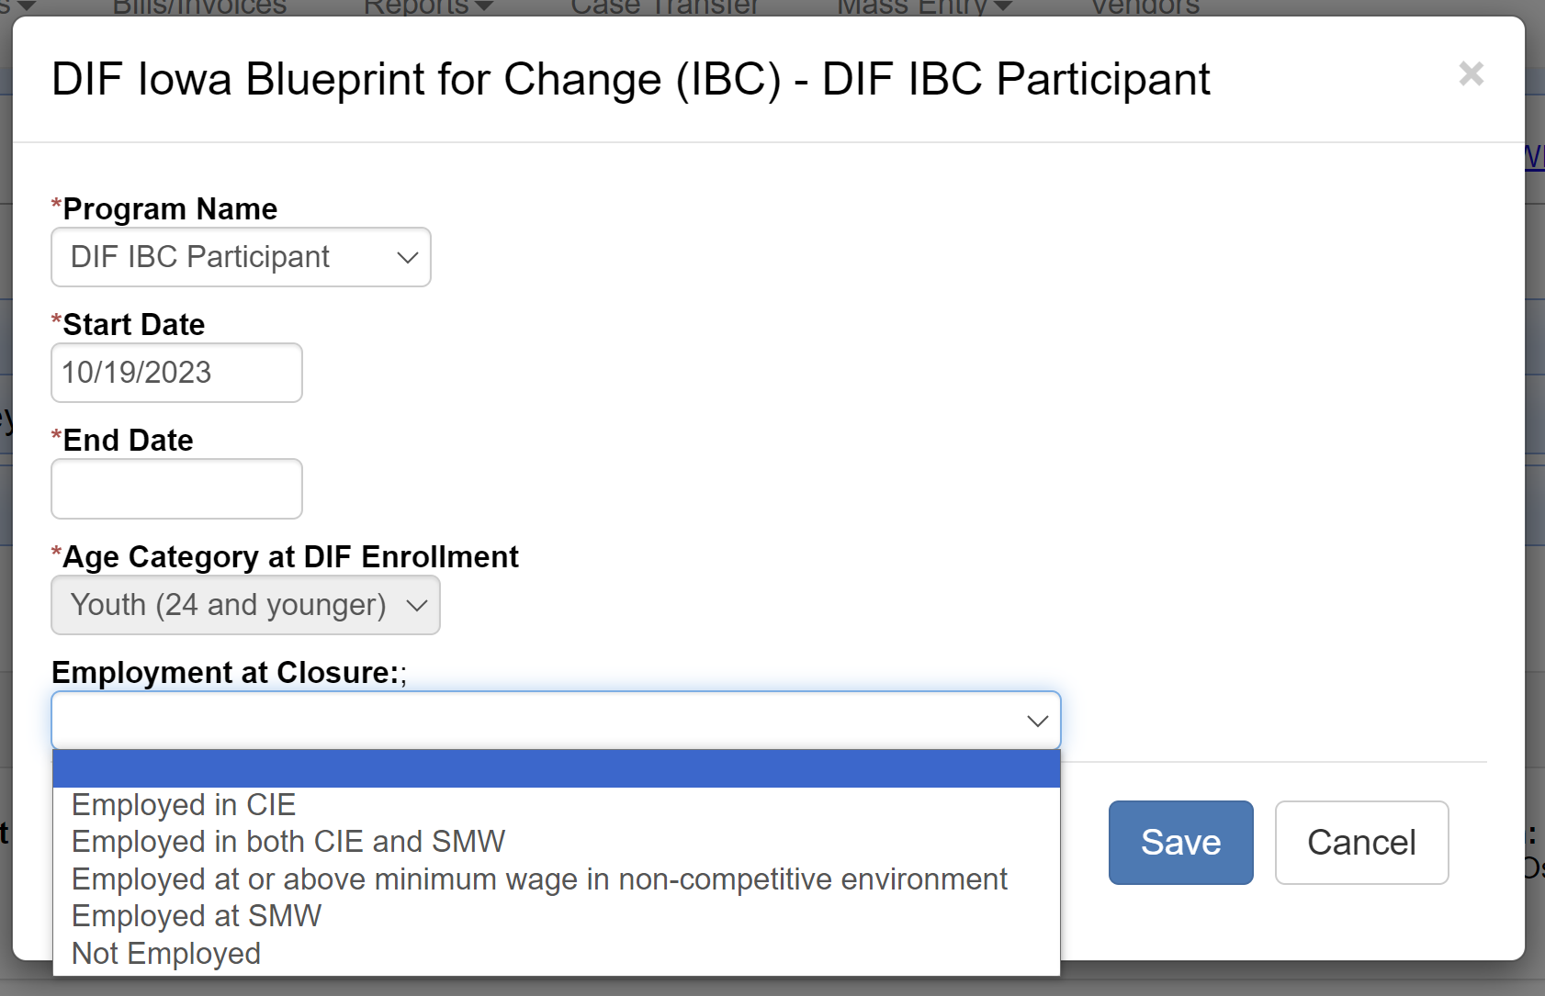
Employment Information at Closure
Notes:
When you are closing the case, you’ll need to go back to the Programs/Contracts tab and edit the program to add the employment information. You’ll choose from the following options:
Employed in CIE
Employed in both CIE and SMW
Employed at or above minimum wage but in non-competitive employment
Employed at SMW
Not Employed

Slide 20
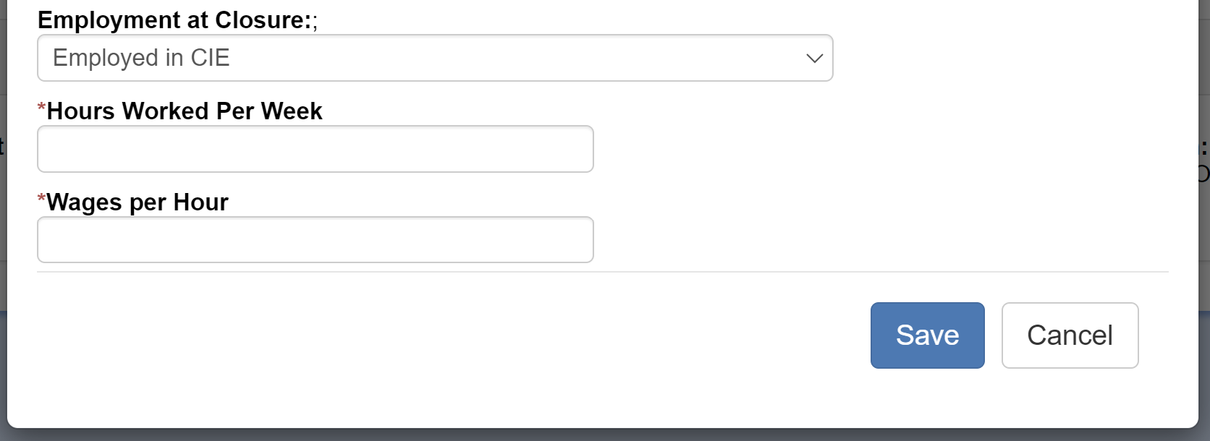
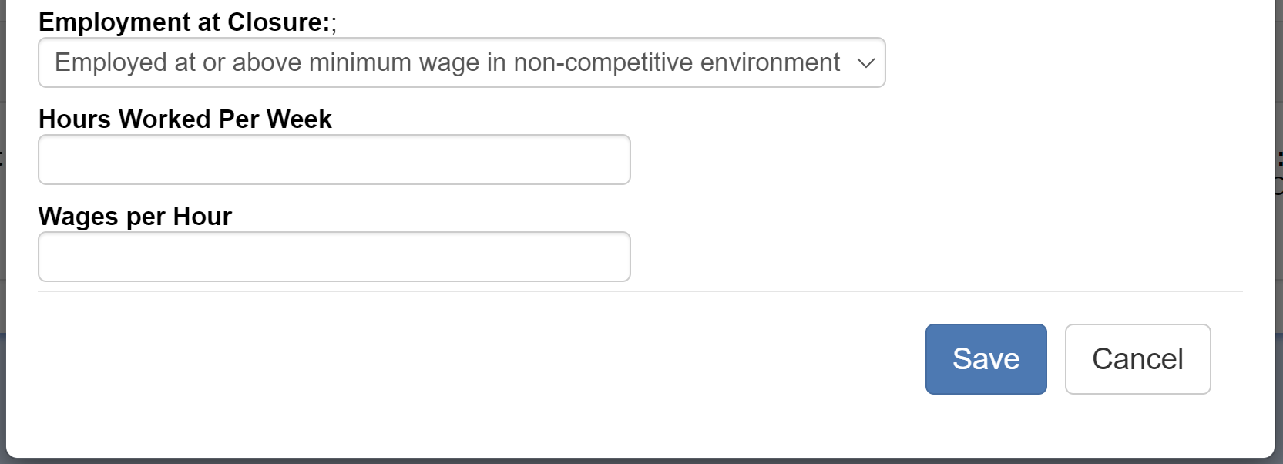
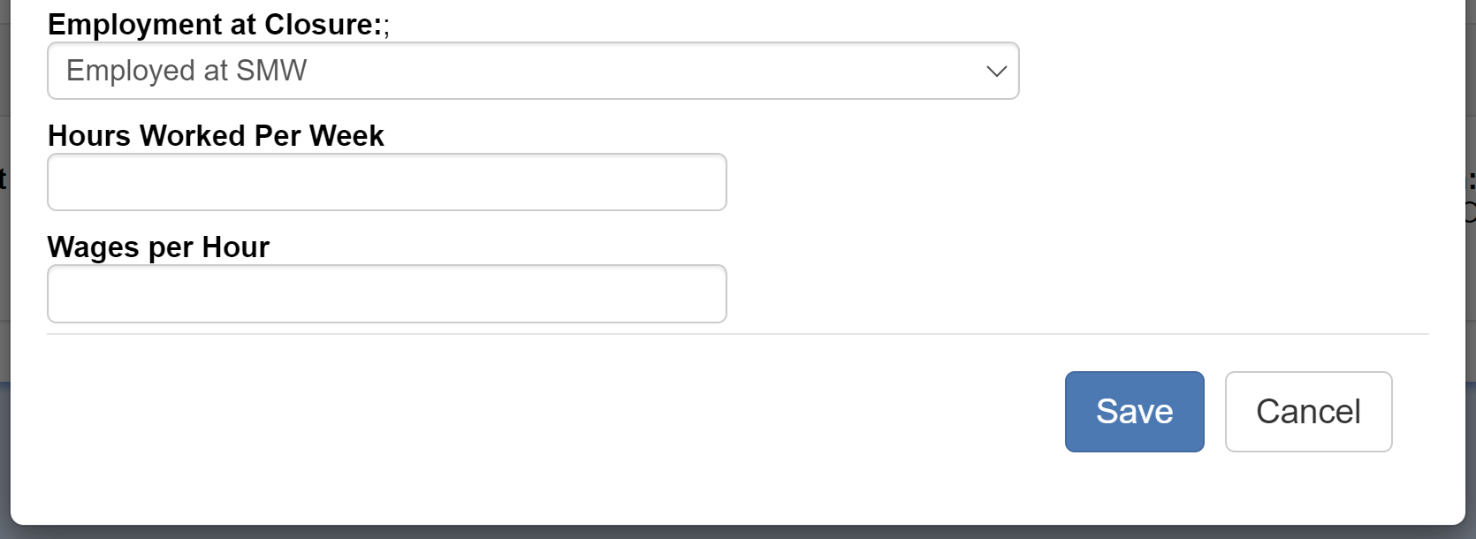
EMPLOYMENT IN CIE
EMPLOYED IN BOTH CIE & SMW
EMPLOYMENT IN NON-CIE SETTING
EMPLOYMENT AT SMW
Notes:
For all selections other than Not employed, IRSS will require you to enter hours and wage information for all types of employment. If the job candidate is working more than one job, whether it is SMW or CIE, you’ll need to average the hours and wages for all jobs before you enter this information. IRSS will validate that all CIE wage information is at or above $7.25 per hour and that all SMW wage information is greater than zero.
Edits have been built into the IPE-3 form to prompt for entry of this information at case closure for all cases that have the DIF program regardless of whether the job candidate is in the participant group or the control group. The DIF team will notify counselors when one of your cases is chosen for the control group so you will know that you need to collect this information at closure.

Slide 21
End the DIF Program
Notes:
Finally, don’t forget to add an End Date when you are closing the case. IRSS will validate for this on approval of the IPE-3 closure form.
You should also add an end date if your job candidate no longer wishes to participate in DIF services but will continue with regular VR services or if the job candidate no longer meets the eligibility criteria. An example of that is when a high school student transfers from a district with a pilot program to a high school that does not have a pilot program. When the DIF project ends, we’ll be asking you to add end dates to the program on all cases even if the case is not closing at that time.

Slide 22
Thank you
for coming!
If you have any questions, reach out to anyone on the DIF team.
Notes:
Thank you so much for taking the time to watch this training. If you have any questions, please feel free to reach out to anyone on the DIF team.

