Slide 1
Menu of Services (MOS) Manual and Service Report Forms Training (2024)
Vienna Hoang, Resource Manager SES
Vienna.Hoang@iowa.gov
515-802-1460
Notes:
Welcome we have a lot of information to share in 2 hours so please ask questions in the chat as needed and Ashley Banes will help me man the chats. If you have a case related question, I may not have time to answer it so send me an email and I will reach out to you individually. Today’s training is on the new MOS Manual and the forms associated with each of the services on our Menu. I do want to give you a quick and brief overview of how we arrived at these changes and updates.
(next slide).

Slide 2
CRP Advisory Team formed (purpose of the team & goals)
Revamp MOS Manual & the forms for all of the services
Ongoing training & improvements
20-21
21-22
22-23
23-24
24+
Issues and Solutions
Training & Implementation
Notes:
2020-2021: CRP Advisory Team formed
Purpose: Help IVRS & CRPs maintain good partnership
Goals:
Tracking (who the CRPs are, services provided, area of coverage)
Communication (how do we maintain good, open communication)
Training (expectations and responsibilities)
Tools (training tools, cheat sheets, triage)
2021-2022: Worked on issues and solutions
We wanted this to be a thoughtful and inclusive process
CRP advisors went to their local offices & their local CRPs to find out the state of the situation and proposed solutions & cross walked what worked/didn’t work
We came back and shared and some things were resolved by sharing solutions offices were doing across the state
Tracking: Developed the CRP Spreadsheet that’s managed by the local CRP Advisor
Communication: I ramped up and began developing a training to begin addressing all forms of communication; look at our communication process
Training: Began developing modules for both VR and CRPs that’s on demand
Tools:
2022-2023: Revamped MOS Manual and all of the forms associated with the services on the MOS
2023-2024: Training & Implementation
I tell you all this because I want you to understand that this was not all just the top people wanting to create work and chaos but there was a lot of thought and input from partners, VR staff and our SRC. Today’s training is focused on the the MOS Manual and the new forms associated with each service on the MOS. I will spend the bulk of today on the forms. So today’s training was born out of Challenges. (next slide)

Slide 3
Challenges…
Multiple policies
CRPs
IVRS
HHS/ME/MCOs/Region
October, 2022 - Administrative Rule Change (ARC) 6419C
Inconsistent application
Inconsistent messaging
Inconsistent messaging
Lack of training
Direct employment service workforce shortage
Professional recognition (credential & salary)
Inconsistent messaging - many cooks in the kitchen
Communication:
Lack of quality documentation,
no communication,
misunderstanding emails/texts
Notes:
These aren’t ALL of the challenges impacting the delivery of SES; they are key challenges that led to the update of our MOS Manual & forms which can be summarized in three main areas:
Multiple policies
CRPs
IVRS
The challenges for us, other funding entities and CRPs is when an individual is involved with multiple agencies that have their own policies guiding what they can/can’t do and how things need to be done. This resulted in (refer to slide); refer to ARC6419C PDF - this change in the checklist of services rendered made it seem like documentation differentiation between reports for IVRS and that of HHS/IME seem like a huge difference when in reality, the only difference is opportunity for growth and that is actually a constant. We typically work with individuals who are just starting off to achieve CIE and by the time JCs get to Waiver services, they are stabilized and services are just to maintain CIE. Therefore, naturally, the report we require would have more variations in it than to check the same boxes claim after claim.
CRPs heard inconsistent messaging not only between agencies but between different individuals within an agency. Other challenges faced by our CRP partners were (refer to slide)
Challenges within IVRS were (refer to slide)
So we looked at areas of solutions (next slide)

Slide 4
Solution
Challenge 1
Challenge 2
Challenge 3
Align doc policies
Same identifying info as HHS (e.g. member name, member ID, date/time start-end, service provided, provider name & credential)
“Narrative only when… atypical event occurs during service encounter”
Checklist
Training
Statewide
Local
Formal-review reports for useful/not useful information
Informal-get to know one another
Ongoing
Pipeline
Direct employment service apprenticeships
Recognized profession:
CESP/ACRE training
IA APSE
College of DirectCourse
4 CEUs/year
Notes:
For today’s presentation, we are focused on that first challenge, doing part of that 2nd challenge and hopefully planting seeds for the 3rd challenge.
Challenge 1 (refer to slide)
Challenge 2 (refer to slide)
Challenge 3 (refer to slide)
Now that you have the history of how we came to where we are, let’s take a look at the new forms and then we’ll touch on the new MOS Manual (next slide)

Slide 5
Documentation
General Principles
If it is not documented, it did not happen
Federal & State laws require providers to maintain the records to support claims billed
Clear & concise service documentation
Accurate & timely
Alignment with that of HHS/ME Iowa Administrative Code
Chapter 79 Section 249
Notes:
The General Principles of Documentation are:
We’ve all heard it, if it isn’t documented, it didn’t happen.
It’s the law.
We don’t need novels but at the same time, we need enough details to make use of the service.
The reports need to also be accurate and timely, otherwise it’s not useful either.
Now let’s take a look at the key details in a report (next slide)

Slide 6
See, touch, hear, taste, smell, and “ESP”
5 Key Aspects for the Documentation of Services
What’s the purpose of the service?
Detailed - does the report provide enough details?
Itemized - each occurrence; # of hours detailed in narrative match # of hours authorized & claimed
Unanswered - what wasn’t answered & new questions?
Recommendations - ES’s insight & expert opinion
Employment Specialist’s Perspectives
“ESP”
Notes:
There are key aspects that you need to always need to keep in the back of your mind as providers provide the service and as documentation are completed for the service rendered:
What’s the purpose of the service? Answering questions, training or just purely observing the JC? What were all of the questions and does the report answer the questions asked by the team?
Does the report provide enough details to justify the time spent on the activities and to justify next steps?
Each occurrence is each time the ES is working on the case. Do the # of hours detailed in the narratives match the # of hours claimed?
Does the report generate more questions that need to be answered in order to support the JC’s employment goal? And what are those questions?
And finally, we require a certain level of training of our providers so we look for what I call their ESP, the Employment Specialist’s Professional Perspectives. Does the report provide details to the ES’s insight and recommendations for services?
If your documentation has at least all 5 of these elements, you should have sufficient information to help you move onto the next steps, pay the claim and generate the next authorization, if appropriate.
So let’s take a look at the forms (next slide)

Slide 7
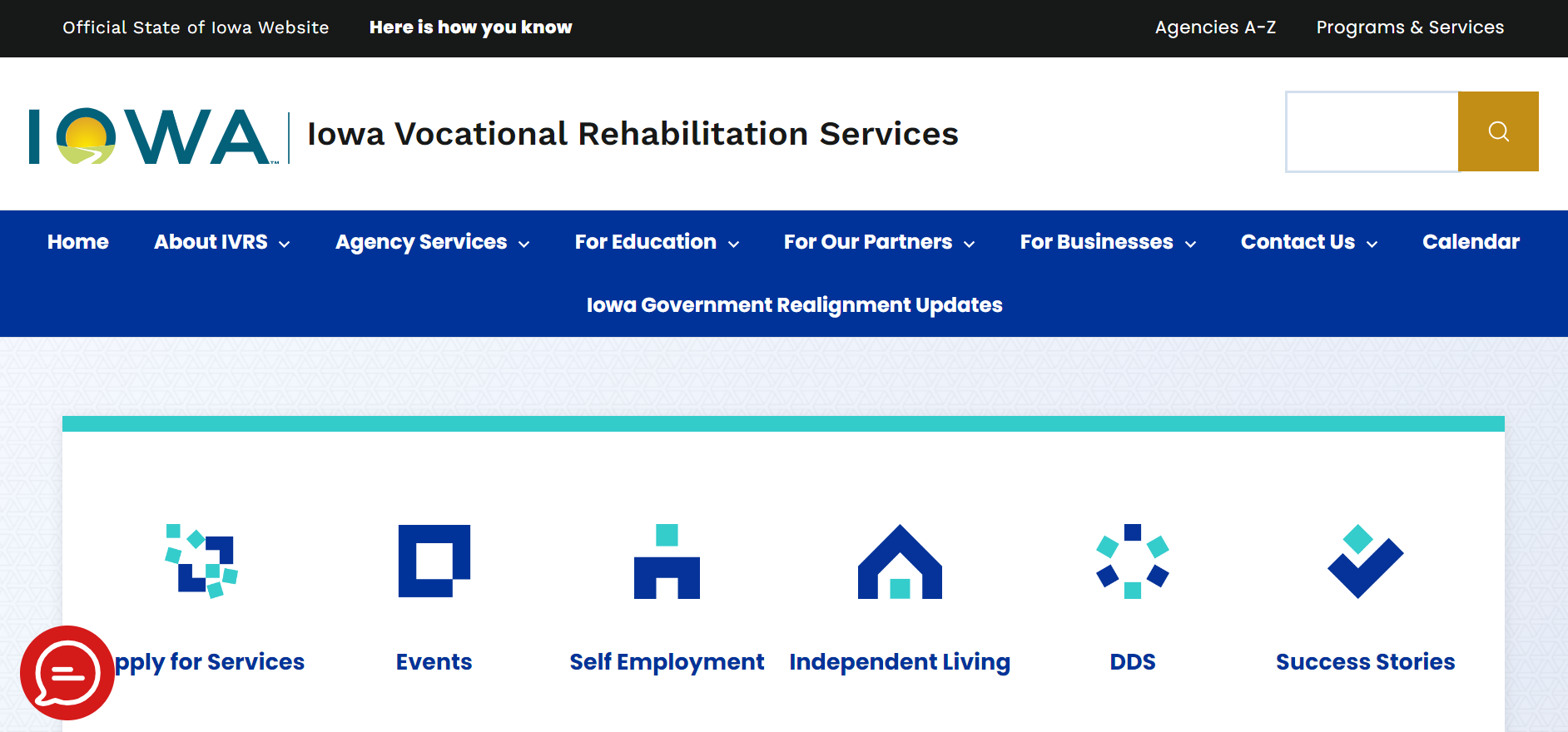
https://ivrs.iowa.gov
Notes:
But before we do, since some of you are new to the agency, let’s review where you can access the forms. They are located in PowerDMS but you can also access them through the VR website. It is important that you understand the purpose of the service being authorized so that the information on the document reflects the purpose. Today, we are focused on the documentation so I won’t go in depth into the purpose of each service but I can’t talk about the documentation without touching on the purpose a little bit. As a reminder, remember that you can always go to our website to read about the purpose for each service at IVRS.iowa.gov but most importantly, the purpose should be discussed in a conversation with the team so that everyone understands the point for doing whatever service it is you are doing. For those who are new, once you are at our website, you’ll click on the Partners tab circled in red (next slide)

Slide 8
Notes:
You’ll get a drop down of options, for the purpose of this training, you’ll choose Community Rehabilitation Programs (CRPs) and it will take you to (next slide)

Slide 9
Notes:
This page where you can look up how much we reimburse CRPs for training wages (yellow arrow) that CRPs pay JCs for any real work JCs do while the CRP is authorized to provide services like the WRA and the WAT. If a CRP is not on that list, we default to reimbursing at $7.25/hr which is the minimum wage rate. I won’t go through everything on this page due to time, so for the purpose of this training, you’d click on CRP Menu of Services again (red arrow). (next slide)

Slide 10
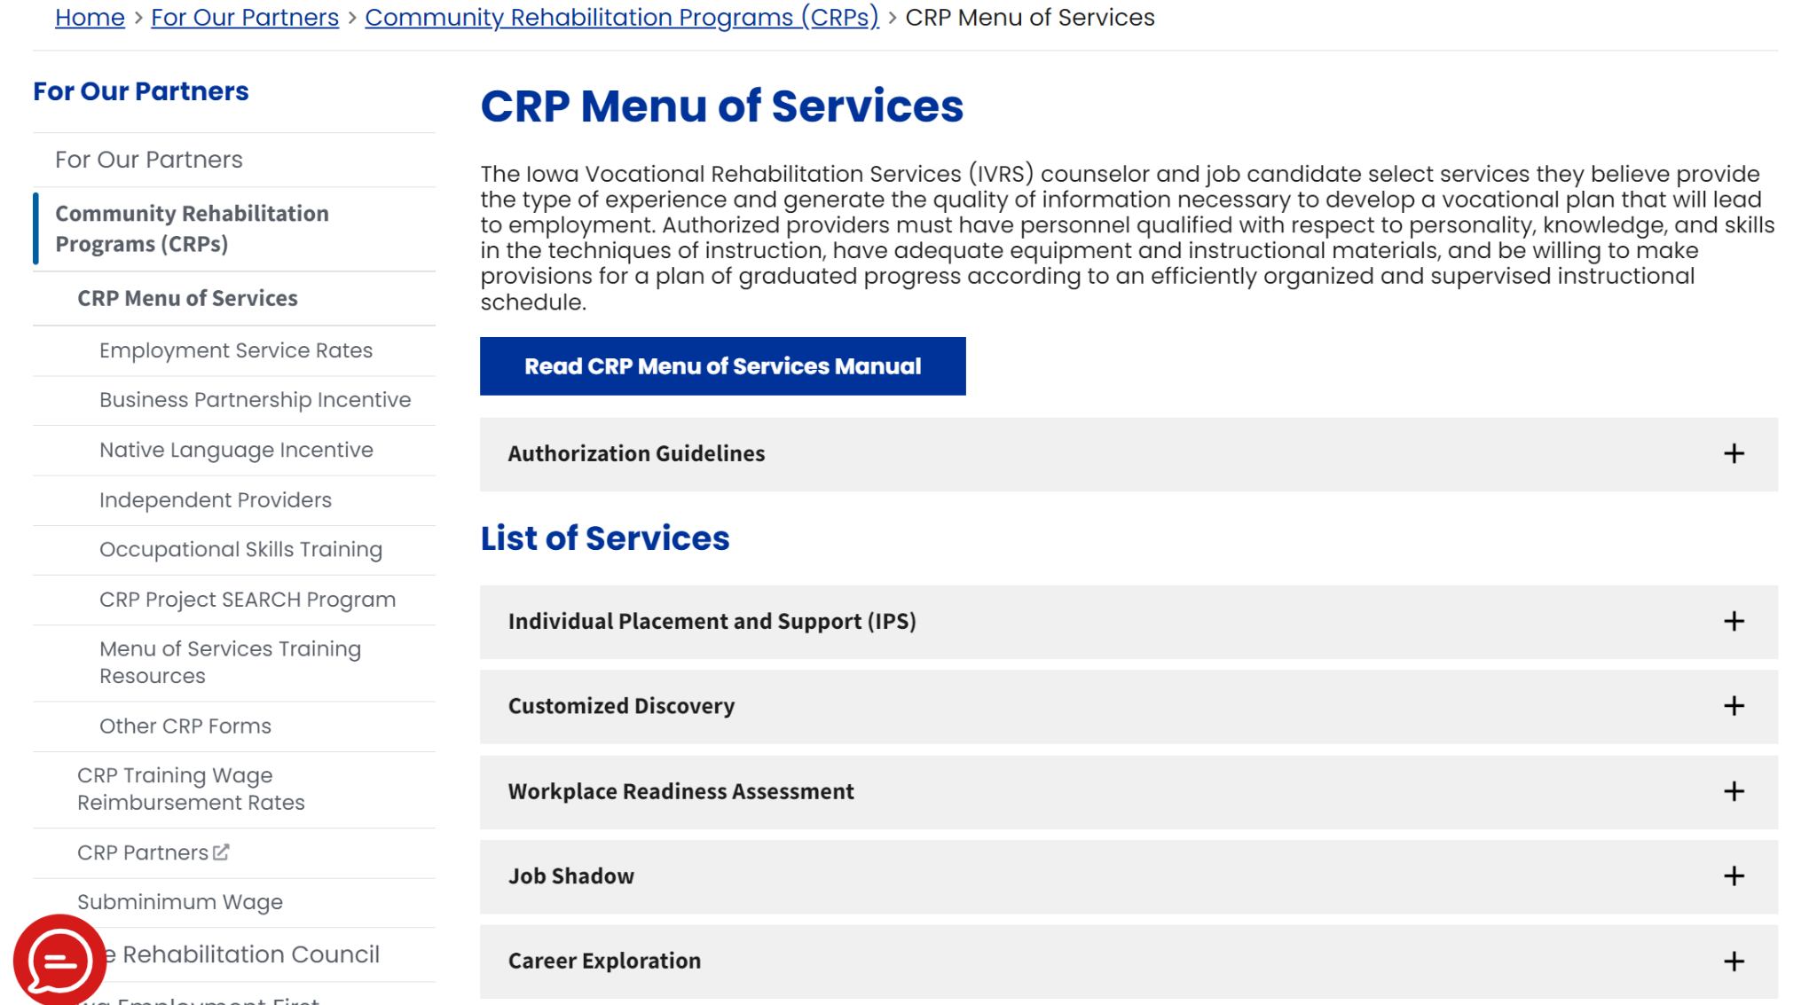
Notes:
You’ll get to the page where all of the services on our Menu is listed out. Quick reminder, this is also the page to see the rates for all of the services and the maximum number of units allowable (red arrows). The Menu of Services Training Resources (orange arrows) is where all of the MOS Modules, videos and PPT or Google Slides can be accessed. The Menu of Services Manual (green arrow) is the narrative version of our presentations and it serves as our agreement between IVRS and our CRP partners. This is where providers may also access the Manual. All CRP ESes will get an email to go through the Manual and sign the acknowledgement sheet and they will also be told on 12/6/23. It’s really important for us to all be on the same page so all IVRS staff will also be expected to sign Acknowledgement through PowerDMS (April, can you tell them how to sign off on it?). The Authorization Guidelines (blue arrow) tab is where you will find a reminder for how services are to be authorized.

Slide 11
Notes:
The bulk of this page is the list of services on our MOS. You’ll scroll down to see the 16 services on our Menu. Each tab follows a general layout. (go to website to discuss the general layout)

Slide 12
Menu of Services (MOS) Manual Key Changes
Order of sections rearranged
New sections added
Updated forms and processes
Removed Sections
Replaced with 2 Step process
Clarification using examples
Notes:
Because there’s so much details and not enough time to go over every possible scenario and details, I am providing a general overview of the changes. As mentioned before, all staff will be required to sign off acknowledging that they have reviewed the MOS Manual. VR staff will sign off via PowerDMS and CRP staff will manually sign off the Acknowledgement page.
True to a large organization, we had 50/50 who said the Manual was too wordy and the other half asking for more details, so you have what we have today. Keep in mind, every possible variation to what ifs is not going to be black and white, so as stuarts of VR’s rules and processes, each VR staff should consult with their supervisors in order to try to consistently apply those rules and processes even though the situation may be unique.
So, what are the key changes to the Manual?
The order of the sections have been rearranged. The previous Manual started with a CRP focus going into provider criteria and the update starts with the purpose of the Manual and goes into how to initiate services. After I review all of the key changes, I will pull up the Manual and go through the pages briefly.
New sections added
Interpreter Services
Native Language Incentive
Expanded Area Incentive
Updated Externship Service
Updated Overview of the Provider Service Agreements section to mirror that of HHS’s Administrative Rules which include information on:
Approved accrediting organizations (added the Council on Accreditation/COA)
The requirement of ESes needing to complete 4 CEUs per year on employment support training
Expectations for providers providing IPS and CD
Documentation
Table on how to count units
Section on virtual services
No shows
Acknowledgement of Understanding
Definitions
Updated forms and process (no longer have forms based on the 4 Sections starting with Section I referral form which we now have the online format. We now have a two step process: step 1 is the application which that form is accessible online and intake process; then step 2 is dependent on what service is being recommended, you’ll use the form and the IPE. If a plan calls for Supported Employment Service, you’ll still use the SEPA form.
Clarification on certain guidances and using examples to help with clarification
So let’s take a look at the new Manual (pull of MOS Manual and go through the pages to discuss areas of changes)

Slide 13
Thank You!!!
MAX growth
Feedback, suggestions for improvement and if you want to join the CRP Advisory team contact Vienna Hoang
Notes:
With all of your ongoing feedback and suggestions, we can achieve quality partnership and manage high quantity caseloads.

