Slide 1
Customized Discovery
Vienna Hoang, Iowa Vocational Rehabilitation Services (IVRS)
Ashlea Lantz, Griffin-Hammis Associates
Jess Kreho, Griffin-Hammis Associates
Jill Daniel, IVRS Carroll
Jen Daniel, New Hope Village
May 27, 2021

Slide 2
What is Customized Discovery (CD)?
Person Centered
Competitive integrated employment (CIE)
Most Significantly Disabled (MSD)
Little to no work history
Leads to a customized job
Notes:
History (Ashlea)
(Vienna) CD is a person-centered approach that leads to a competitive integrated employment outcome. CD is appropriate for job candidates who are most significantly disabled, haven't worked, worked primarily in segregated settings, or had little vocational success. Candidates who know their vocational goal are not appropriate for CD. The results from each process of CD are used to generate information by identifying a job candidate's skills, interests, abilities, conditions, contributions, and support needed for employment to design a pathway to a career that focuses on the individual's interest, talents, and contributions (not limitations); to customize a job in the community that does not exist if needed based on the information identified; and provide consultative support to ensure the candidate is successful.
Person Centered - really challenges the VR person’s and the ES’s way of thinking. It is because of this that makes CD a service that puts the E1st philosophy into action.
Traditionally, Discovery was supposed to lead to a comprehensive report that’s supposed to help you get to know the JC and understand who this person is with hopes that it would help you decide what the next steps should be. We weren’t getting that. The reports that we were getting yielded no more information than what was gathered through our intake process. With CD, we are getting high quality reports that details skills, knowledge, abilities and conditions with 3 confirmed vocational themes that direct customized job development. Example - we are not doing Discovery and hoping for an entry level TJ Maxx job but example (Jess)

Slide 3
Fees for CD
Grand Total: (up to)
$10,861.76 per JC!!
Payment I -Discovery
$68.48/hr up to 40 hours for CD
$683 for the completion of the Vocational Profile Report/DSR
Payment II - Customized Job Development
$68.48/hr up to 40 hours customized job development
$68.48/hr up to 10 hours for customized employment
Payment III - Consultative Supports/Job Coaching
$46.76/hr up to 80 hours for consultative support/supported employment job coaching
$68.48/hr up to 2 hours for a natural support plan and report
Notes:
Jess & Ashlea
Emphasize that we’ve looked into 40 hours of job development at the professional level

Slide 4
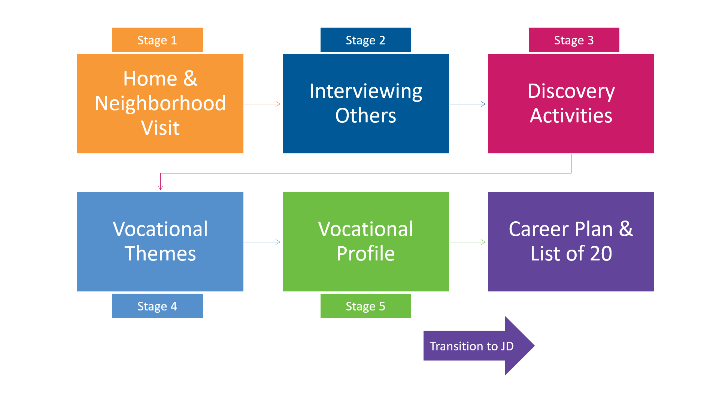
Process & Outcomes of CD & Customized JD
Outcomes:
Vocational Profile (completed DSR)
Visual Profile/Portfolio
Plan for Customized Job Development via Lists of 20
Always Competitive Integrated Employment
Consultative Supports
Natural Support Plan
Informational Interviews & Approach
Social Capital/Warm Contacts
Focus on small, artisan businesses
Notes:
Jess

Slide 5
Required credentialed CD provider & training supports
FY2022 - Initial training
Successfully complete an ACRE-CE approved training (certificate of completion should state: ACRE with an Emphasis on Customized Employment)
Meet with the local VR office to discuss Customized Discovery service needs
Participate in supplemental training/COP as arranged by GHA over the course of FFY2022
Ongoing training
Participate in annual IVRS training on CD
Ongoing TA support through GHA for FY2022
Oversight
CRP RM & local VR staff reviews DSR for quality
Ongoing TA support through GHA for FY2022
Fidelity reviews
http://www.acreducators.org/certificate-registry
Notes:
(Jess & Ashlea)
ACRE certification ensures that provider is trained in customized employment services - why we require ACRE training
Meet with local VR office to ensure there is a need for services and there is at least 1-2 VR staff who understands the CD philosophy, process & fidelity. VR office should identify a minimum of 3 JCs.
Training with GHA ensures provider understands and adheres to the fidelity model
Ongoing training & TA solidifies quality of outcomes & IVRS expectations

Slide 6
Going forward with CD Services
Changes from current discovery service
CD only available to MSD
Direct CIE outcome, not just an assessment report
Immediate authorization for Customized Job Development following CD (there is action beyond the report).
The completed Discovery Staging Record lists 60 businesses with three vocational themes to transition into Customized Job Development
High School Students
Other services on IVRS Menu still available for freshmans & sophomores
Career Exploration
Job Shadow
Job Seeking Skills Training
Workplace Readiness
Work Adjustment Training
CD could be used with Juniors and Seniors who could benefit from CD
Notes:
Vienna

Slide 7
Going forward with CD Services
Changes from current discovery service
No newly trained fidelity reviewers
VR staff will be trained on what to expect from referral to outcome based on fidelity
TA provided to ensure consistent service delivery
Communication
Routine/monthly meetings w/ CRPs to review progress, troubleshooting issues & discuss potential referrals
Notes:
Vienna

Slide 8
New Hope Village & IVRS Parternship
Key factors to our success:
Communication
Routine meetings
TA w/ GHA
CRP-IVRS to review cases
Open mindedness
Notes:
JDx2

Slide 9
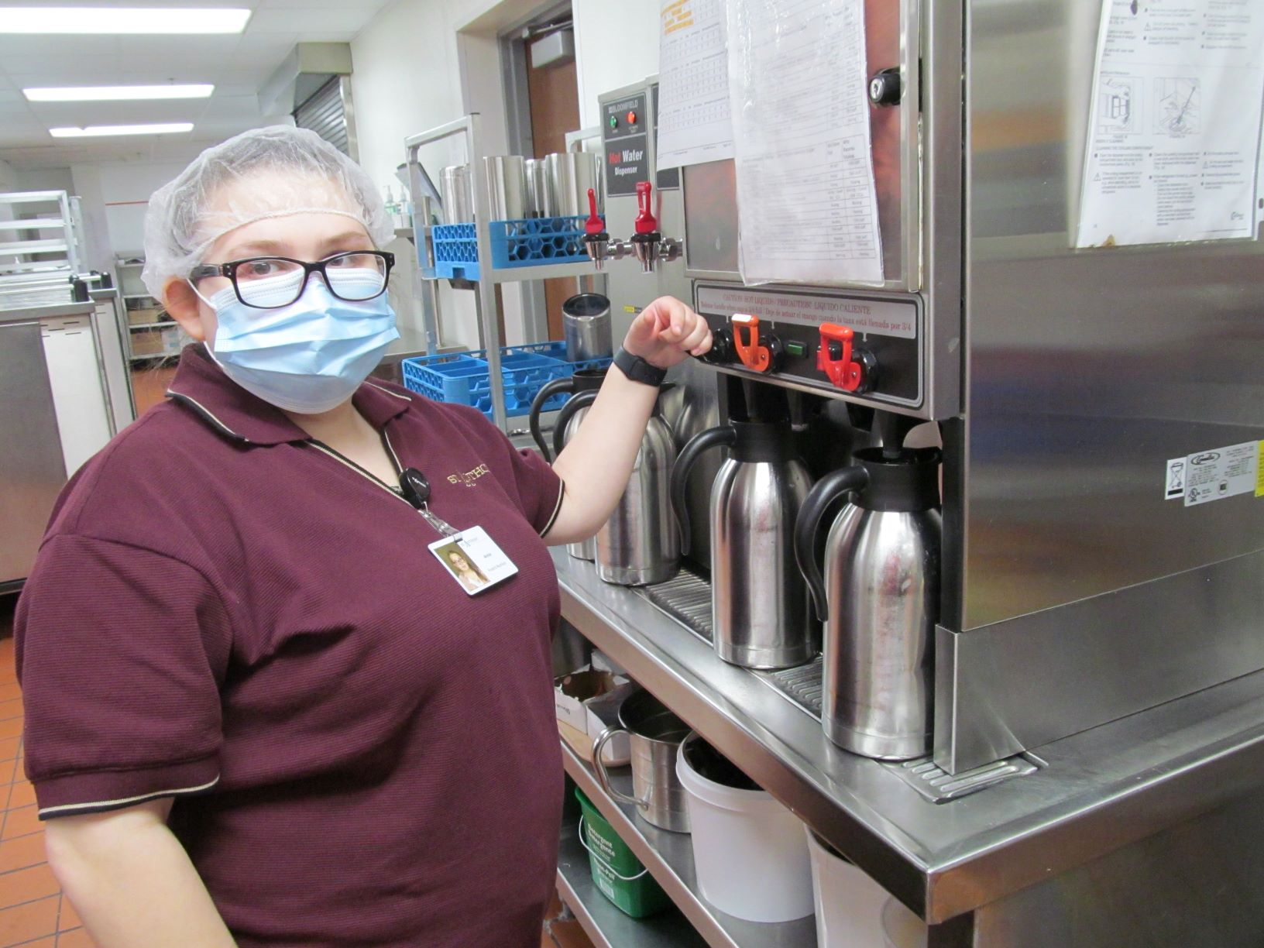
Success Story
Meet Annie A!
Began Discovery senior year, graduated last week!
Annie’s Themes: Helping People (Young/Old) Animals/Animal Care, Cooking/Baking/Food service.
Employed at St. Anthony Regional Hosp./Dietary Department.
-Began part time as a HS student.
More to come for Annie…
Notes:
JDx2

Slide 10
Schedule

Slide 11
Finalize plans with IME & GHA
Tracking of current & future CD outcomes to DD Council & VR
Start of Customized Discovery statewide
05/21/2021
05/27/2021
06/2021
07/30-08/30
9/30/2021
10/01/2021
CD Information Session for CRPs & IVRS
ACRE trainings begins focused on CE
Follow up with CD providers & end of discovery on VR Menu

Slide 12
???Questions???

